Slide 1
Pictures for “How inclusive and safe are your latrines?” activity

Slide 2
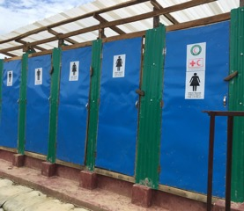

Slide 3
