Slide 1
RAMP (1:12 MAX SLOPE)
RAMP (1:12 MAX SLOPE)
CV
1.00m TBC
CV
LANDING - SAME LEVEL AS LATRINE FLOOR
SOLAR LAMP
1.00m TBC
0.90m
HANDRAILS
LOCK
CV
SOLAR LAMP
LOCK
0.90m
FLOOR SPACE FOR TURNING A WHEELCHAIR (1.5m DIA)
FLOOR SPACE FOR CHANGING
HANDRAILS
HANDWASHING AND LAUNDRY POINT
HANDWASHING AND LAUNDRY POINT
1.80m
2.40m
SOLAR LAMP
SOLAR LAMP
DRAINAGE
DRAINAGE
WATER CONTAINER
WATER CONTAINER
RUBBISH
BIN
W.C.
RUBBISH
BIN
W.C.
1.80m
1.80m
DAPS LATRINE PLAN
DAPS LATRINE PLAN WITH WHEELCHAIR ACCESS

Slide 2
SOLAR LAMP
SOLAR LAMP
HANDWASHING AND LAUNDRY POINT
LOCK
HANDRAILS
WATER CONTAINER
W.C.
LANDING - SAME LEVEL AS LATRINE FLOOR
RUBBISH
BIN
VARIOUS LATRINE SYSTEMS
DRAINAGE
RAMP (1:12 MAX SLOPE)
1.00m TBC
1.80m
DAPS LATRINE SIDE ELEVATION

Slide 3
SOLAR LAMP
SOLAR LAMP
HANDWASHING AND LAUNDRY POINT
LOCK
HANDRAILS
WATER CONTAINER
W.C.
FLOOR SPACE FOR TURNING A WHEELCHAIR (1.5m DIA)
LANDING - SAME LEVEL AS LATRINE FLOOR
RUBBISH
BIN
VARIOUS LATRINE SYSTEMS
DRAINAGE
RAMP (1:12 MAX SLOPE)
1.00m TBC
2.40m
DAPS LATRINE WITH WHEELCHAIR ACCESS SIDE ELEVATION

Slide 4
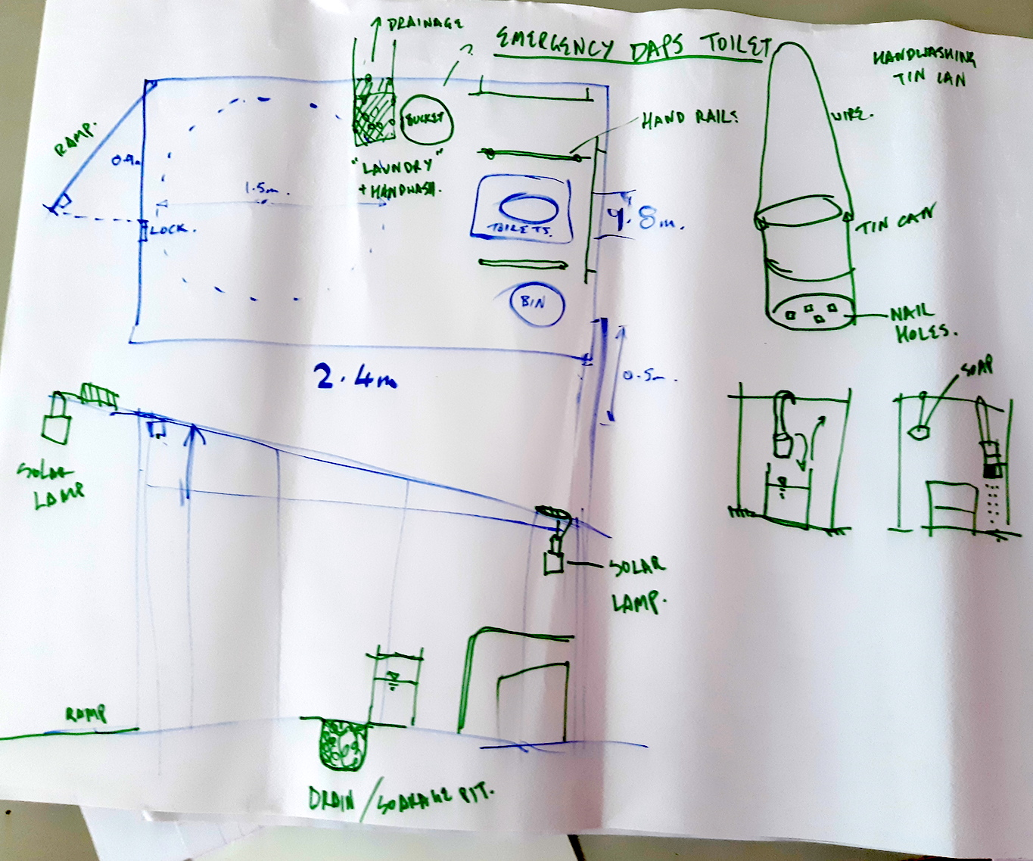
VRCS DAPS LATRINE DESIGN FROM MHM WORKSHOP
28/3/19

