Slide 1
Cholera & OCV (Oral Cholera Vaccines) Session #01 – General understanding of cholera, cholera treatment and cholera prevention
Date, Place
Notes:
Register participants
Official opening and recitals

Slide 2
Session overview
Cholera key facts
How to recognize Cholera ? What are the signs & symptoms ?
Cholera transmission
Cholera prevention
Cholera outbreak response

Slide 3
1- Cholera key facts
What do you know about cholera ?
Please tell us !

Slide 4
The story of cholera
Notes:
What did you think about the film?
Did it change your perception of the disease / the words you associate with cholera?
Raise the issue that you do not see cholera, unlike in the film.

Slide 5
Key facts about cholera
The infectious agent is a small bacteria (Vibrio cholerae)
Causes acute watery diarrhea
Leads to dehydration
May lead to death in a matter of hours (if not treated)
People don’t die “from cholera”.
They die because they get severely dehydrated (due to excessive diarrhea) and the body cannot survive without enough water.
cholera diarrhea dehydration severe dehydration death

Slide 6
Key facts about cholera
Cholera affects EVERYONE - both children and adults (even healthy adults)
Unlike other diarrheal diseases, it can kill not only children but also healthy adults if left untreated
Pregnant women & Children under 5 are at greater risk of severe outcome (and death)
Notes:
This means that if you see some cases, there might be more.

Slide 7
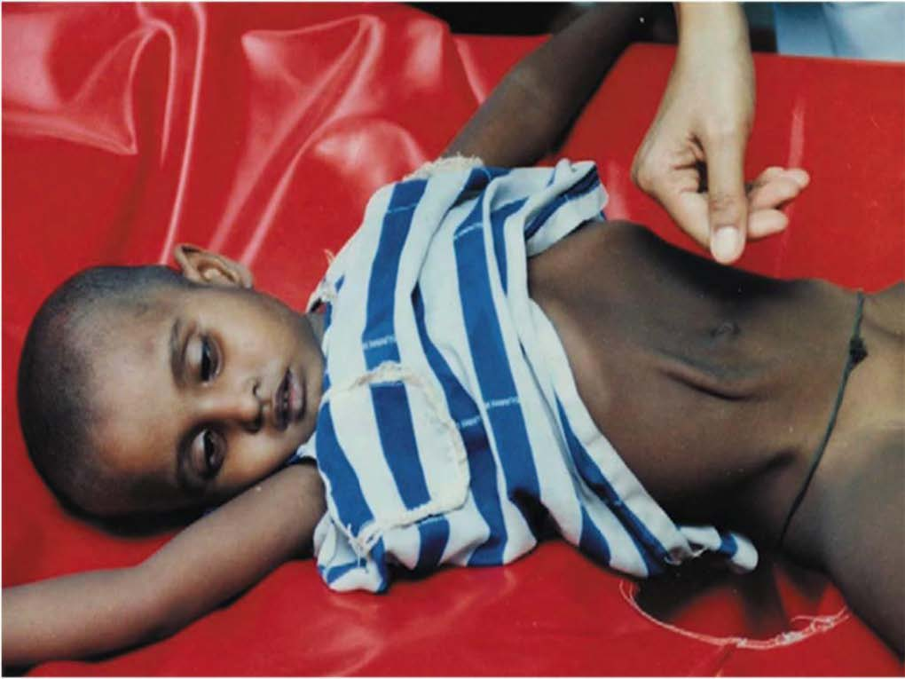
2 - How to recognize Cholera ? Signs & symptoms ?
Dehydration
AWD - Acute watery diarrhea with/without vomiting
Looks like “rice water stools”
No smell
Acute: sudden onset, appears “out of nowhere”
Watery: Liquid and it looks like “rice water”
AWD: Profuse, 3 or more loose stools a day
Sunken eyes (eyes that seem to go inside)
Very dry mouth
Very weak / unconscious
Not able to eat/drink or breastfeed
Skin pinch goes back very slowly

Slide 8
Saving Lives
Good News !
Dehydration can be easily treated .
With early access to rehydration – less than 1% of those infected will die. Early access to rehydration saves lives
80% of cholera cases can be successfully treated in the community simply through drinking oral rehydration solution
Severely dehydrated cases (less than 20%) need Intravenous (IV) rehydration at a health center, (cholera treatment center, or hospital

Slide 9
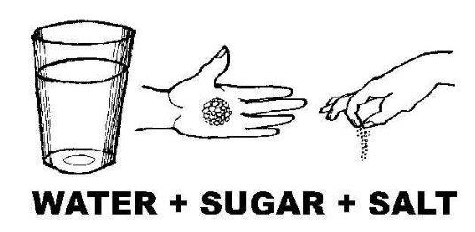
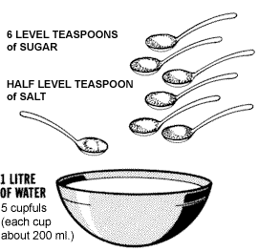
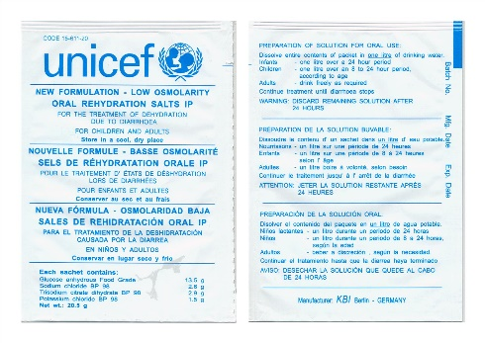
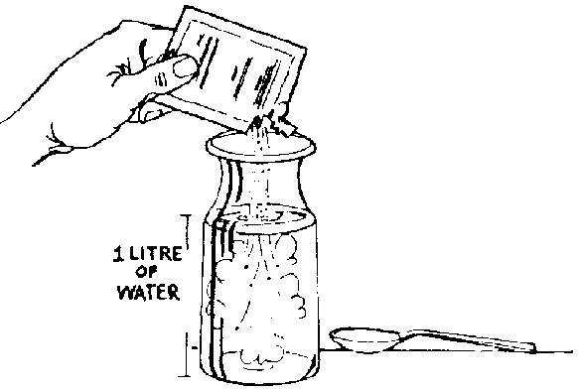
Saving Lives
What are Oral Rehydration Solutions ?
Home – made ORS Solution
Already Prepared Powder – ORS Sachets
Potable water
Notes:
Schema de ORS – Préparation d’une solution Sucrée Salée – ou a partir d’un sachet d’ORS

Slide 10
How much ORS should a person drink?
AGE | IN THE FIRST 4 HOURS | AFTER 4 HOURS | AFTER EACH LOOSE STOOL
Children under 5 | - | Give 1L of ORS to rehydrate on the way to health center | Refer to health center in non-outbreak time
Children between 5 and 14 years old | 1L (5 cups) | 1L / day (5 cups) 1 ORS sachet | 1 cup (200 mL)
Over 15 years or older | 2L (10 cups) or more | 2L / day (10 cups) 2 ORS sachets | As much as wanted
Explain / Show how to prepare ORS at home
Explain to discard old ORS solution after 24h (at the end of the day) and prepare a new the next day
Ask to come back if not improving / not able to drink/eat

Slide 11
Activity
Why are people still dying of cholera ?
What stops people from getting oral rehydration treatment ?
Notes:
Physical context – distance from health centre, distance from those with medical training, lack of potable water
Economic/market context – ORS unavailable in the village, people have little money and will not buy ORS, people do not treat water due to cost of fuel for boiling or treatment chemicals
Education and Knowledge – don’t know the symptoms of cholera, don’t know dehydration symptoms, don’t understand how cholera is spread, don’t know how to mix ORS or use sugar and salt to make ORS,
Perception – do not perceive the risk to life of cholera, are used to having bouts of diarrhoea and do not recognise difference , wish to avoid negative associations which come with admitting one has cholera

Slide 12
3- Cholera Transmission
Infected
Individual
Susceptible,
Not Infected
Individuals
Some will be infected
And some will not
Cholera is an infectious, communicable disease, which follows the faeco-oral transmission route

Slide 13
Reducing Cholera Transmission
Infected
Individuals
Susceptible,
Not Infected
Individuals
Some will be infected
And some will not
Target infected individuals = Early detection & treatment
> Oral rehydration therapy
Notes:
Si on veut maintenant limiter la transmission, on peut agir à 3 niveaux
Agir sur les individus malades : Que peut on faire par exemple ?
Oui, on peut les soustraire à la communauté (lazarets)
On peut les traiter, pour réduire le temps pendant lequel ils sont contagieux (et en plus leur sauver la vie)
C’est ce qu’on fait au CTC = lazaret + traitement + gestion des excreta pour ne pas contaminer l’environnement

Slide 14
Reducing Cholera Transmission
Infected
Individuals
Susceptible,
Not Infected
Individuals
Some will be infected
And some will not
 Interrupt the transmission between infected individuals and the rest of the community
> Branch Outbreak Response Teams
Notes:
Renforcer les barrières sanitaires : Qu’est ce que ca veut dire concretement, de quoi on parle ici ?
Plusieurs choses (on verra plus tard plus en détail) :
Il s’agit d’une maladie a transmission féco-orale : Il faut donc travailler sur les barrières à la contamination féco orale.

Slide 15
Reducing Cholera Transmission
Infected
Individuals
Some will be infected
And some will not
Susceptible,
Not Infected
Individuals
Protect the rest of the population
(ex : prevention, vaccination)
> Community Engagement, WASH interventions, Oral Cholera Vaccination

Slide 16
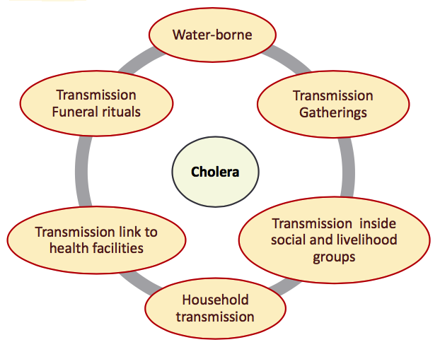
Reducing Cholera Transmission
Importance of identifying
the main “Transmission contexts”
=
Key places / occasions where people get cholera
Source: ACF Cholera Guidelines
Notes:
In most cases, people get infected :
With unsafe drinking water
While participating to mass gathering (and eating)
While participating to a funeral without proper handling of the body and belongings or during funeral meals
While taking care of the sick patient at home
While going to the health facility and being in contact with sick patients
Because they have a particular risk/ exposure linked to their profession

Slide 17
Reducing Cholera Transmission
What can be done at community level (1/2) ?
Keep the community members informed
Ensure that cholera awareness and risk perception is high
Ensure that signs and symptoms are well known
Notes:
In most cases, people get infected :
With unsafe drinking water
While participating to mass gathering (and eating)
While participating to a funeral without proper handling of the body and belongings or during funeral meals
While taking care of the sick patient at home
While going to the health facility and being in contact with sick patients
Because they have a particular risk/ exposure linked to their profession

Slide 18
Reducing Cholera Transmission
What can be done at community level (2/2) ?
If a household suspects a case, they should
see the community ORT volunteer
drink ORS
go to the nearest health facility
Ensure that cholera prevention messages are delivered widely
Avoid unnecessary gatherings and community meals
Avoid participating in a funeral – or ask for
support for the organization of a “risk-free” funeral.
Notes:
In most cases, people get infected :
With unsafe drinking water
While participating to mass gathering (and eating)
While participating to a funeral without proper handling of the body and belongings or during funeral meals
While taking care of the sick patient at home
While going to the health facility and being in contact with sick patients
Because they have a particular risk/ exposure linked to their profession

Slide 19
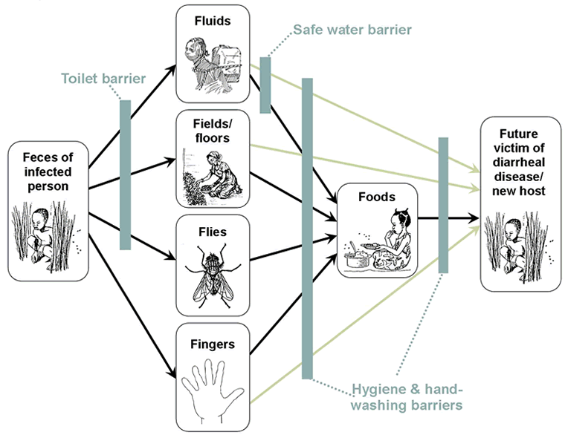
4- Cholera Prevention
Faeco-oral
Transmission

Slide 20
Activity
In your group decide what will be the main messages you will give the community to cut the transmission routes shown in the F-Diagram.
Notes:
Answers on the next slide

Slide 21
Key messages for cholera prevention (1/2)
Drink safe water (treated and safely stored)
Handwash with soap at key moments (after defecation or cleaning a child’s bottom, before preparing or eating food or feeding a child) and also child’s hands

Slide 22
Key messages for cholera prevention (2/2)
Cook food well, eat it hot, keep it covered, and peel fruits and vegetables.
Use latrines or bury your faeces (not open defecation)
Clean up — in the kitchen and in places where your family bathes and washes clothes, & latrines.

Slide 23
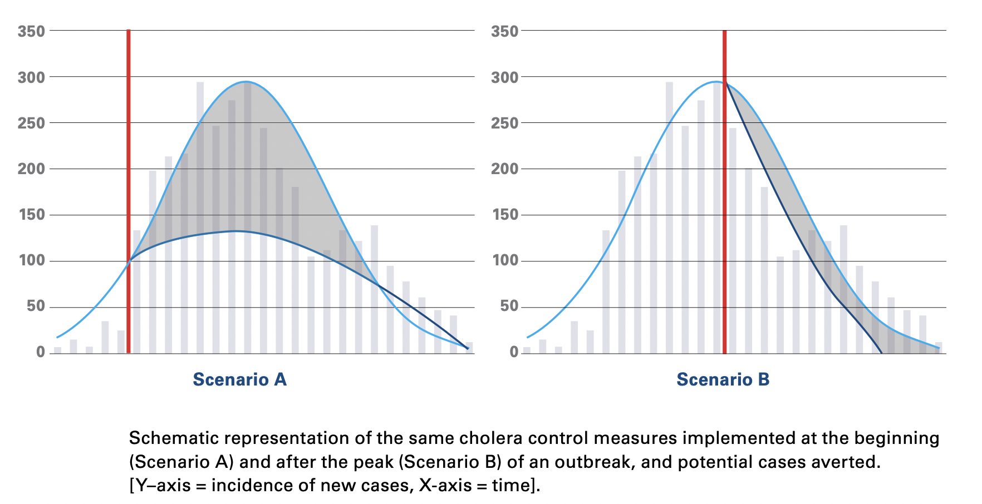
5 - Cholera outbreak response
Early response
Late response
(at the peak of the outbreak, or after the peak)
Low number
of cases averted
(pretty similar to the
“no response” scenario)
Important number
of cases averted
Early detection
NB: The response can be very well designed and implemented
– it will be close to useless if not on time !

Slide 24
5 - Cholera outbreak response
The most important element of a cholera response = being on time – i.e. ahead of the outbreak !
How do we do this ?
Know your ennemy: In peace time, improve your knowledge of the disease = identify cholera hotspots, at risk populations, seasonality, risk factors and risky behaviors and translate it into contingency plans
Prepare for the response: Train your teams, revise your contingency plans, prepare stocks, reherse emergency responses through simulation exercises, etc.
Capacitate communities (the first able to respond are the communities themselves): Train community volunteers who will be able to detect early suspicion of outbreaks and at the same time provide early treatment
Be accountable to the local health autorities: to confirm outbreaks quickly, trigger local and national response, share views on the outbreak evolution and adapt the different response activities according to evolving needs
Coordinate with others: to clarify who is doing what where to avoid duplication and optimize resources

Slide 25
5 - Cholera outbreak response
PILARS OF A CHOLERA RESPONSE
COORDINATION
SURVEILLANCE AND ANALYSIS OF OUTBREAK DYNAMIC
CASE MANAGEMENT: TREATEMENT OF CHOLERA CASES
WATER, SANITATION AND HYGIENE PROMOTION
COMMUNITY ENGAGEMENT & RISK COMMUNICATION
ORAL CHOLERA VACCINATION

Slide 26
Activity
PILARS OF A CHOLERA RESPONSE
For each pillar, state what are the main stakeholders involved and how the Red Cross can contribute ?
COORDINATION
SURVEILLANCE AND ANALYSIS OF OUTBREAK DYNAMIC
CASE MANAGEMENT: TREATEMENT OF CHOLERA CASES
WATER, SANITATION AND HYGIENE PROMOTION
COMMUNITY ENGAGEMENT & RISK COMMUNICATION
ORAL CHOLERA VACCINATION

Slide 27
Activity
HOW THE RED CROSS
CAN CONTRIBUTE ?
PILARS OF A CHOLERA RESPONSE
WHO IS RESPONSIBLE ?
COORDINATION
SURVEILLANCE AND ANALYSIS OF OUTBREAK DYNAMIC
CASE MANAGEMENT: TREATEMENT OF CHOLERA CASES
WATER, SANITATION AND HYGIENE PROMOTION
COMMUNITY ENGAGEMENT & RISK COMMUNICATION
ORAL CHOLERA VACCINATION

