Slide 1
Module 4 : Oral Cholera Vaccine campaigns

Slide 2
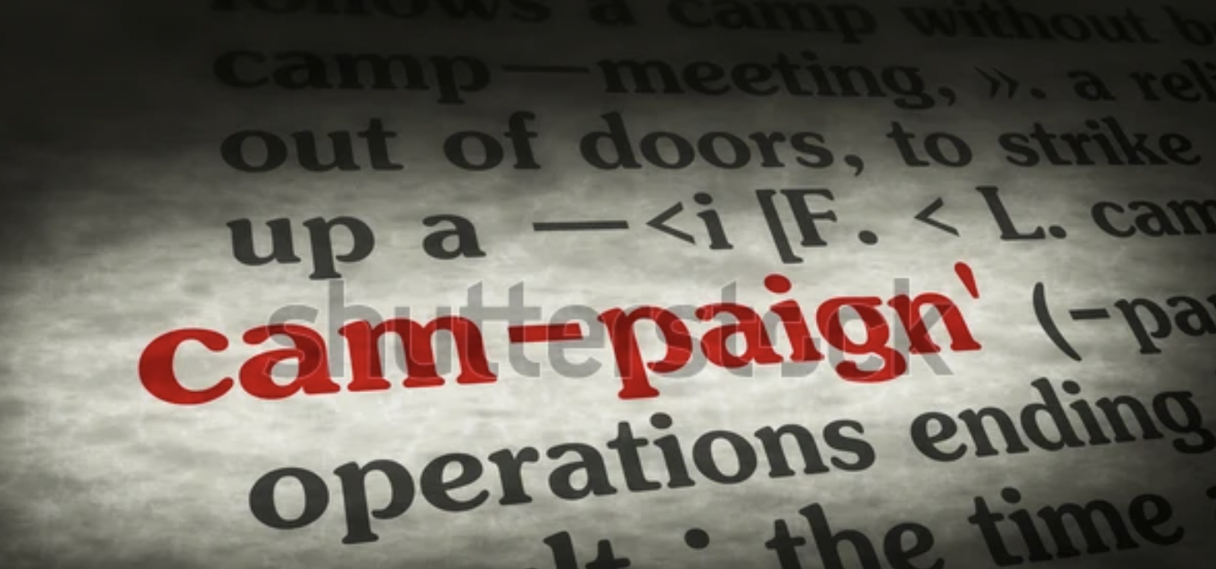
Oral Cholera Vaccine campaign - definition
Campaign = is a planned set of activities carried out over a limited period of time in order to achieve something.
Vaccination campaign = refers to the process / set of activities that will lead to the vaccination of the targeted population at the appropriate time
Different types of campaign
“Reactive” campaigns (emergency) = in response to an outbreak
“Preventive” campaigns (prevention) = in anticipation of an outbreak

Slide 3
Oral Cholera Vaccine campaign - timing
Before the campaign
During the campaign
After the campaign
Timeline

Slide 4
Before the campaign
Before the campaign
Objective of the “Before the campaign” Phase = Prepare well in order to maximize the vaccine coverage
Barriers to high vaccine coverage are :
Availability of vaccines / access to vaccination sites
Public understanding and trust (vaccine acceptancy)
Complexity of the vaccine series / process

Slide 5
Before the campaign
Before the campaign
(1/3) Availability / Access - How to adress the availability & access issue
Planning: Ensure equitable access to vaccination sites (location, distance, opening hours, etc.)
Planning: Ensure adequate vaccine supply - shortages in vaccine are more frequent than one may imagine.
This can happen at national level (overall lack of vaccine doses) if vaccine request and number of vaccine received are not corresponding.
Need to match identified needs and availability of vaccine doses received. Prioritize (have a prioritization plan).
Anticipate a % of vaccine doses wastage (plan 10% buffer)
Mismatch happen more frequently at sub-national level (incorrect repartition of vaccine doses between geographical areas or incorrect estimation of target population figures).
Need to have a buffer of vaccine doses at regional / district level to be able to adapt to changes in estimated population between local communities – and a plan B to use the buffer if not used.

Slide 6
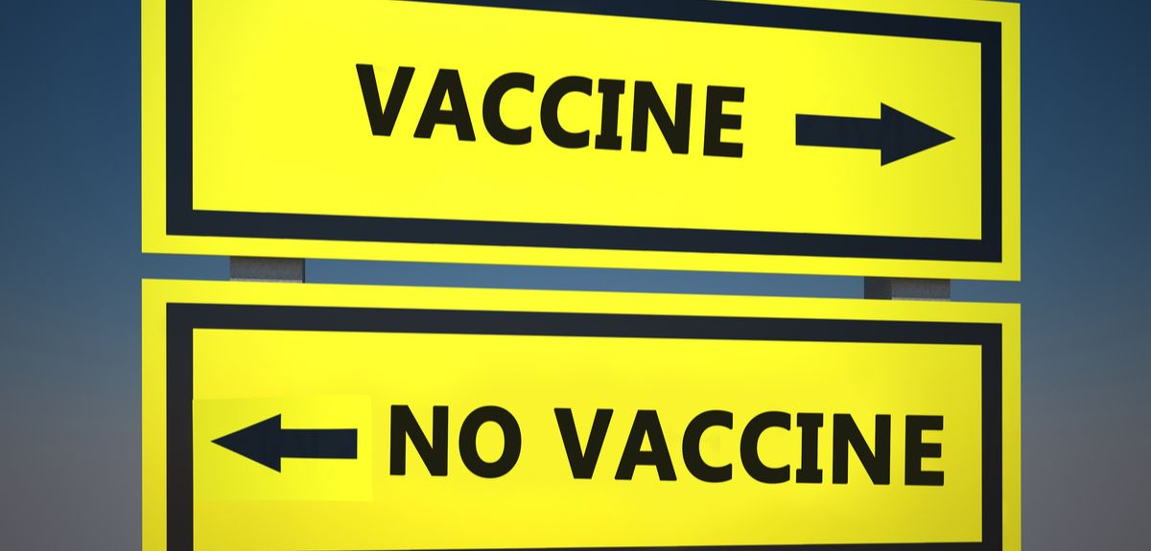
Before the campaign
Before the campaign
(2/3) Public understanding and trust : How to adress the vaccine hesitancy issue
Reasons for vaccine hesitancy include:
Concerns about vaccine safety
Perception of low likelihood of contracting the disease
Perceived low severity the disease
Beliefs that vaccines do not work
Measure the vaccine acceptancy (baseline survey), and identify barriers to vaccine acceptance
Organize risk communication and community engagement activities (RCCE) based on survey results
Measure improved vaccine acceptancy (follow up survey)

Slide 7
Before the campaign
Before the campaign
(3/3) Complexity of the vaccine series / process : How to adress the vaccine roll out complexity
OCV campaigns typically happens in 2 rounds of vaccination (2 doses) separated by 2 weeks to 6 months.
Problem: Vaccine delivery in 2 rounds may lead to lower final vaccination rate / coverage – because some individuals may only come to the first round and receive only one dose out of the two doses that are recommended. Or may only come to the second round without having previously received the first dose.
Early communication on the process (2 rounds) with clarity on the vaccination calendar (dates of the 2 rounds)
Stress the importance of receiving 2 doses – inefficacy of receiving one dose only (protection not durable)
Possible incentive to ensure higher attendance for the second dose if low attendance for the 2d round expected (for. Ex. Certificate of vaccination; soap or disinfectant, aquatabs, etc.)

Slide 8
During the campaign
During the campaign
Tales from previous OCV campaings: What does an OCV vaccination campaign look like ?
Preparation
Macroplanning
At national level
(identification of high risk areas)
Social Mobilization
Communication plan
Messages
Mass Media campaign
Logistics
Order of vaccines
Custom clearance
Transport / Storage
Social Mobilization
Between 2 rounds
At least 2 weeks before
the start of the vaccination
Monitoring AEFI
(Adverse events)
Preparation
Microplanning
At district level
(population
figures)
Training
Field teams
Timeline
Implement
First round
Implement
2d round
Logistics
Vaccine Repartition
Transport / Storage
At disctict level
Set up
Vaccination
Posts / teams
Supervision

Slide 9
During the campaign
During the campaign
Tales from previous OCV campaings: What does an OCV vaccination campaign look like ?
Mass vaccination campaign involving more than 50 000 people may be implemented in as little as 3 weeks.
If the campaign has been well planned, all elements are in place, and that the population is willing to support
The 2 doses of vaccine must be administered strictly between a minimum of 2 weeks and a maximum of 6 months apart.
Not respecting this timing jeopardizes the protective efficacy of the vaccine.
The majority of people come for vaccination during the first 2 days, weekends and the last day.
It is preferable to plan vaccination rounds not exceeding 6 days (2 days before the WE + 2 days of WE + 1 or 2 day after)
Only people that have received the 1st dose are authorized to receive the 2nd dose of vaccine during the 2nd round.
Authorizing people to get their 1st dose during the 2nd round session will oblige to organize a 3rd round within 6 weeks to permit these people to receive their 2nd dose.

Slide 10
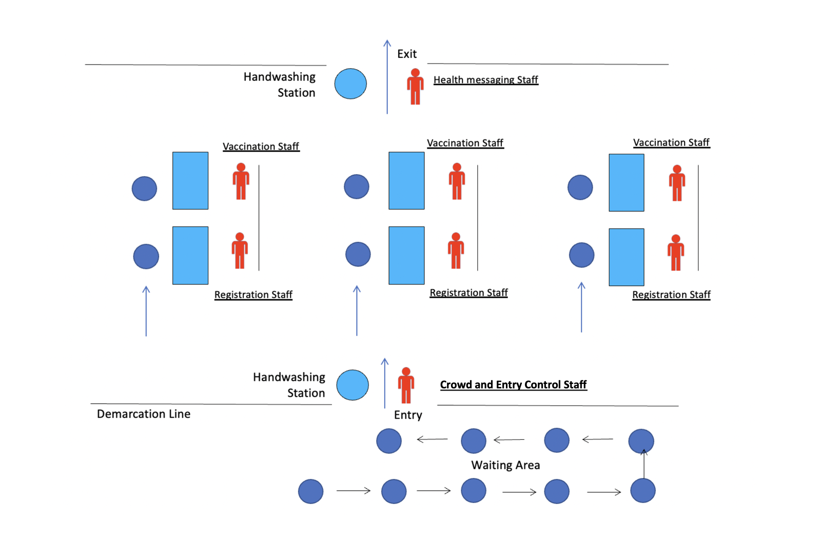
Vaccination Post – Floor plan
During the campaign
FLOOR PLAN

Slide 12
Vaccination Post – Patient Flow
During the campaign
1- Waiting area – queuing is organized with floor signage and a crowd controller
2- Registration – patient is given a vaccination card and explained to keep it for the second round in 2-4 weeks
3- Vaccination – patient is given an opened vial and asked to drink it under vaccinator supervision (self administration). Vaccinator wash hands with alcoholic handrub between each patient.
4- Health messaging & handwashing before exit. Key messages include:
Message 1 = Vaccines are efficient AGAINST cholera, but do not protect you against other diarrheal diseases – continue to follow standard WASH precautions (safe water, handwashing at key times, safe food preparation and handling, use of latrine)
Message 2 = Vaccines are very safe, but we want to follow up any adverse event – so please report to health centers if vomiting, diarrhea, or any other unusual reaction is observed between today and 2 weeks.
Message 3 = Vaccine protects you well if 2 doses are taken. Please come back with vaccination card in 2-4 weeks.
Patient can ask any question on the vaccine or cholera.

Slide 13
Vaccination Post – Team composition
During the campaign
A vaccination team consists of a minimum of 4 people:
Person 1: Controlling the crowd and giving out information and explanation on the process
Person 2: Registration. Responsible for screening for eligibility and filling out the immunization card.
Person 3: Vaccinator, responsible for opening the vaccine and checking the full ingestion of the vaccine, and filling in tally sheets and stamping (or signing) the immunization card.
Person 4: Communicates health education messages and explaining to come back for 2d round

Slide 14
Alternative – Door to door campaign
During the campaign
Vaccination teams at least 3 persons (one recorder, one mobilizer, and one registrar)
Challenges
Number of teams
The teams will carry enough vaccines to cover 30/50 households (approximately 250/300 people per day)
Vaccine cold chain need to be maintained and the vaccines transported using a sufficient number of vaccine carriers and ice packs.
Team composition in Somalia = 313 teams (3,000 vaccinators, recorders, social mobilizers, cold-chain technicians, independent monitors, and supervisors).

Slide 15
After the campaign
After the
campaign
Monitoring AEFI - Adverse Events Following Immunization
What is an AEFI ?
An adverse event after immunization is a symptom or disease that follows immunization and is not necessarily a consequence of the use of the vaccine.
In general, AEFI may be due to:
A reaction to the vaccine itself–most being mild or short-term
An error in how the vaccine is administered
Anxiety on the part of the vaccine recipient
Something other than the vaccination (that is, a “coincident event”)
OCVs have a strong safety profile:
Only about 1 in 50 people taking the vaccine report any side effects, and are mainly gastrointestinal upset.
OCV side effects are generally mild, last only a few hours, and do not require treatment.
Most common complaints after taking OCV:
Upset stomach
Diarrhea
Vomiting
Nausea
Notes:
Nevertheless, as with any vaccine, even those with a long history of safety, a surveillance system should be in place to monitor possible adverse events. During mass immunization campaigns there is often an increase in adverse events—either real or perceived—being reported.This increase may be due to the large number of vaccinations performed in a short period of time, resulting in a concentration of events.Thus it may be helpful to establish a system for detecting such events. Even though the vaccine has been found to be safe in the past, the system to detect adverse events, should they occur, is reassuring to the individuals being vaccinated and to health officials alike.
During the vaccination session, the vaccinator or health educator should tell everyone receiving the vaccination:
That an adverse event is possible.
Common adverse events include stomach upset, diarrhea, nausea and vomiting but that these are almost always mild and do not last very long.
Where to seek care in case they experience an adverse event that is severe or persistent.

Slide 16
After the campaign
After the
campaign
Estimating vaccination coverage from data collected during vaccination
What is Vaccination coverage =
Vaccine coverage is a measure of the success of the vaccination campaign.
It is the estimated percentage of the population who have received the vaccine (or have received the required number of vaccine doses that are recommended for giving protection)
NB: Vaccination coverage should be calculated for each round to determine the percent of people who received a single dose and of those who received two doses.
Notes:
The tally sheets and count of vaccine vials should provide an accurate number of the persons vaccinated each day in each vaccination site (the numerator).
The more difficult challenge is to obtain an accurate number of people in the target population (the denominator).This can be especially difficult due to population movement, inaccurate census data or projections, or multiple sources of population data, all with different estimates.
It may therefore be necessary to obtain a new estimate of the target population before starting the vaccination campaign.This could mean:
Carrying out a new, rapid census of the population in the target areas.
Using surveys to calculate the density of the population and extrapolate these figures to the area covered by the campaign.
Using satellite images to estimate population figures.
The most accurate way of obtaining vaccination coverage is by conducting a vaccine coverage survey after the vaccination campaign. Instead of using administrative data, a survey involves selecting a representative sample of households in the target area and asking them about their participation in the campaign, and checking vaccination cards as confirmation.

Slide 17
Role of the RC and volunteers in the campaign
1 - In which activity do you think the Red Cross could / should be involved ?
2 - State in which activity you or your national society have been involved
Notes:
The tally sheets and count of vaccine vials should provide an accurate number of the persons vaccinated each day in each vaccination site (the numerator).
The more difficult challenge is to obtain an accurate number of people in the target population (the denominator).This can be especially difficult due to population movement, inaccurate census data or projections, or multiple sources of population data, all with different estimates.
It may therefore be necessary to obtain a new estimate of the target population before starting the vaccination campaign.This could mean:
Carrying out a new, rapid census of the population in the target areas.
Using surveys to calculate the density of the population and extrapolate these figures to the area covered by the campaign.
Using satellite images to estimate population figures.
The most accurate way of obtaining vaccination coverage is by conducting a vaccine coverage survey after the vaccination campaign. Instead of using administrative data, a survey involves selecting a representative sample of households in the target area and asking them about their participation in the campaign, and checking vaccination cards as confirmation.

