Slide 1
EVCA Process and Urban WASH
NOVEMBER 2024

Slide 2
AGENDA
Context
EVCA
Action Plan
WASH Activities
Challenges

Slide 3
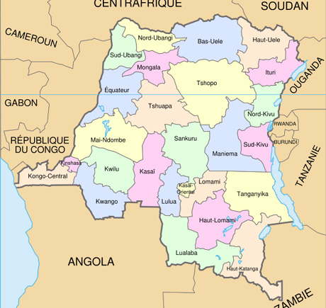
Context
EVCA
Action Plan
WASH Activities
Challenges
Questions
Democratic Republic of Congo
The country is divided into 26 provinces
With nearly 110 million populations
It faces a number of challenges, including war in its eastern part.
Ethnic conflicts
Epidemic with Mpox and Cholera

Slide 4
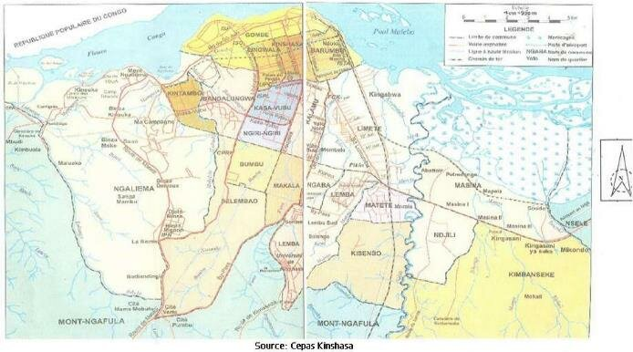
Context
EVCA
Action Plan
WASH Activities
Challenges
Questions
Kinshasa:
Capital of the country with over 17 million populations
Seat of the political institutions (executive, judicial and legislative powers)
The city is subdivided into 24 communes.
Urbanisation outdated, resulting in flooding, lack of gutters and waste management problems
Problems with electrification and water supply.

Slide 5
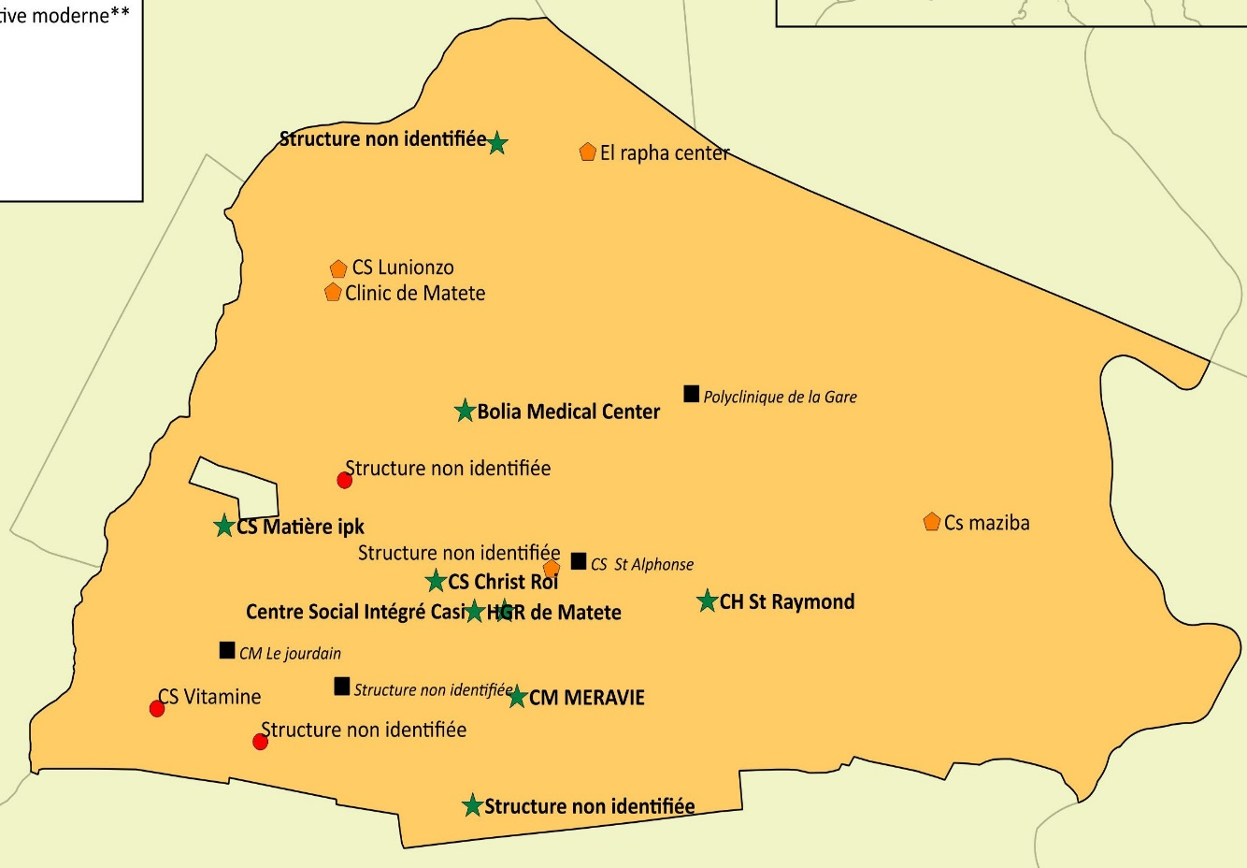
Context
EVCA
Action Plan
WASH Activities
Challenges
Questions
MATETE (Maziba)
Number of population: 16,095
Districts located in the N'djili river catchment area
Communities exposed to disasters such as flooding

Slide 6
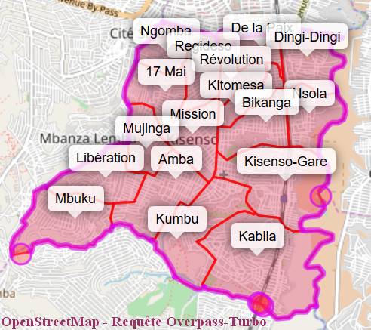
Context
EVCA
Action Plan
WASH Activities
Challenges
Questions
KISENSO (Dingi-Dingi, Nsola et Kisenso Gare)
Number of populations: 98,884
Neighbourhoods located in the N'djili river catchment area
Communities exposed to disasters such as flooding, erosion and strong winds

Slide 7
Context
EVCA
Action Plan
WASH Activities
Challenges
Questions
Enhanced Vulnerability and Capacity Assessment
Stage for community resilience
Engage and connect
Learning for resilience
Understanding risk and resilience
Taking action to strengthen resilience

Slide 8
Context
EVCA
Action Plan
WASH Activities
Challenges
Questions
Disaster Risk Management
Health
Water and Sanitation
Shelter
Food and Nutrition
Economic Opportunities
Infrastructures and services
Natural Ressource Mangement
8 Sectoral dimensions

Slide 9
Context
EVCA
Action Plan
WASH Activities
Challenges
Questions
3 Social dimensions
Social cohesion
Inclusion
Connectedness

Slide 10
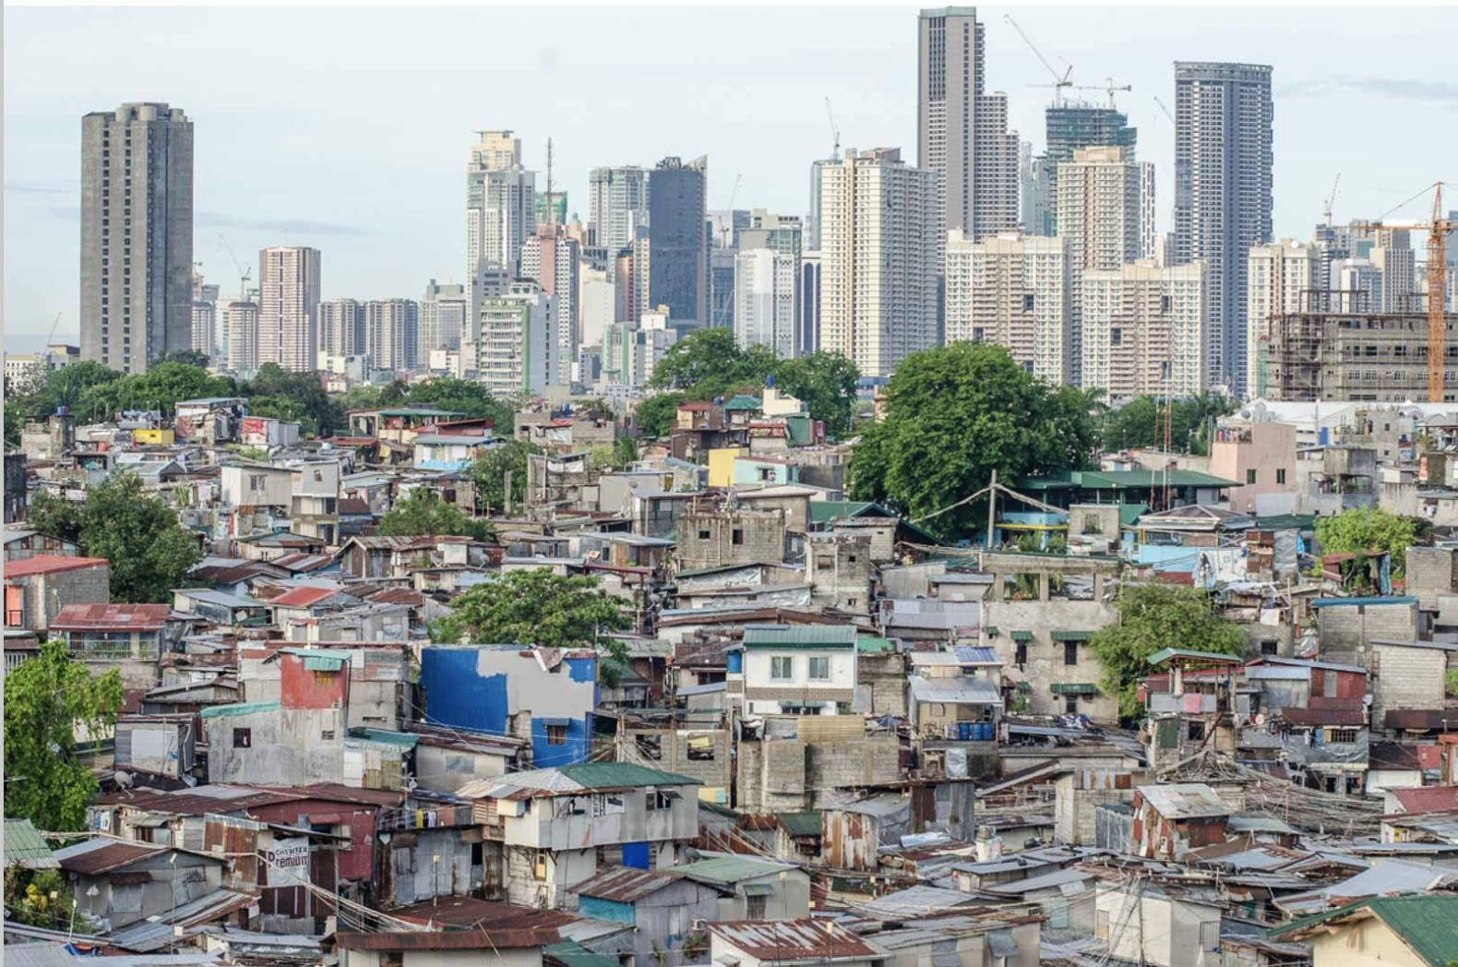
Context
EVCA
Action Plan
WASH Activities
Challenges
Questions
WHAT IS URBAN?
Although there is no common definition of the term ‘urban’, it can be said that cities are living places that generally have the following characteristics:
-A dynamic and mobile population.
- Scale and density of the population.
-Population diversity.
-Varied livelihoods and economic systems.
-Large areas of informal settlement.
-Shifting frontlines, opportunistic crime and access to justice
problems.
-Reduction in basic services.
-Dependence on information technology.
- Cash-based economy.

Slide 11
Context
EVCA
Action Plan
WASH Activities
Challenges
Questions
HOW DOES THIS AFFECT OUR APPROACH?
Urban contexts force us to think:
-Density
-The effects of a hazard are rapid and widespread
-Dynamics
-Cities are made up of interdependent systems and the failure of one system can have an exponential negative effect on the others, particularly on vital services (e.g. loss of electricity).
-Populations are not homogeneous
-Communities are not uniformly located, they are spread over large areas.
-Communities overlap
-Communities are mobile

Slide 12
Context
EVCA
Action Plan
WASH Activities
Challenges
Questions
Once the assessment has been carried out, the results will enable us to understand the main risk factors, vulnerabilities and capacities of each community.
The next step will be to draw up an action plan covering the 11 dimensions, but very often the plan is too ambitious.
This is why it is necessary to establish priorities the actions to be carried out according to the skills and capacities of the National Society.
For other actions, it is a good idea to support communities in their advocacy with local authorities or other organisations.

Slide 13
Context
EVCA
Action Plan
WASH Activities
Challenges
Questions
PROBLEMS | ACTIVITIES | PERIODE | REQUIRED | MANAGERS | OUTCOMES
Gutters clogged | - Cleaning the gutters | Every week-end (8-11h) | Rakes, shovel, spade, boots, hard gloves, pickaxe, mask | Gabriel KAKONDE President ONG FODAV et notable | Gutters are clean and clear
Poor waste management | - Train volunteers and community members in waste management - Raise public awareness - Remove waste from gutters and households | January 2023 | rickshaw, wheelbarrow, megaphone, bin bag | André KAPUKU Coordonnateur CR | Waste is removed, treated and recycled
Difficult access to drinking water | - Build fountain points and/or lobby Regideso | February 2023 2023 | Pipes, cement, bricks and others materials | Comité mixte : CR ONG MALITA | The population has access to drinking water
Presence of insects after flooding | - Train volunteers and community members on how to disinfect households - disinfect households, toilets and gutters, etc. | February 2023 After the floods | Sprayer, PPE, mask, etc. | André KAPUKU Coordonnateur CR | The neighbourhood has been disinfected

Slide 14
Context
EVCA
Action Plan
WASH Activities
Challenges
Questions
STANDARD
DESCRIPTION
OUTCOMES
A resilient community can meet its basic water and sanitation needs.
Include acces to safe drinking water, practices in water treatment, hand-washing and personal hysiene, as well as access to and use of hygienic latrines.
reducing the risk of water-borne diseases (e.g. diarrhoea) and increasing knowledge of good hygiene practices.

Slide 15
Context
EVCA
Action Plan
WASH Activities
Challenges
Questions
Mass awareness and household visits.
Cleaning gutters.
Training volunteers and community members on WASH.
Waste collection and sorting
Building fountain posts.
Building ecological latrines

Slide 16
Context
EVCA
Action Plan
WASH Activities
Challenges
Questions
It is difficult to build latrines because the area is subject to flooding and it is important to find the best approach and type of toilet so as not to harm the community.
Lack of public rubbish tips.
It is not easy to find space to build community infrastructure.
Management and maintenance of infrastructure.

Slide 17
Questions ?

