Slide 1
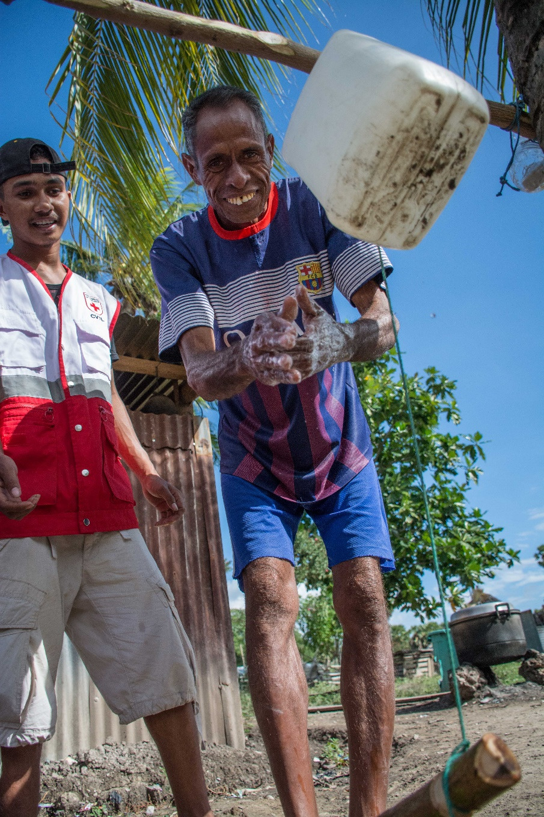
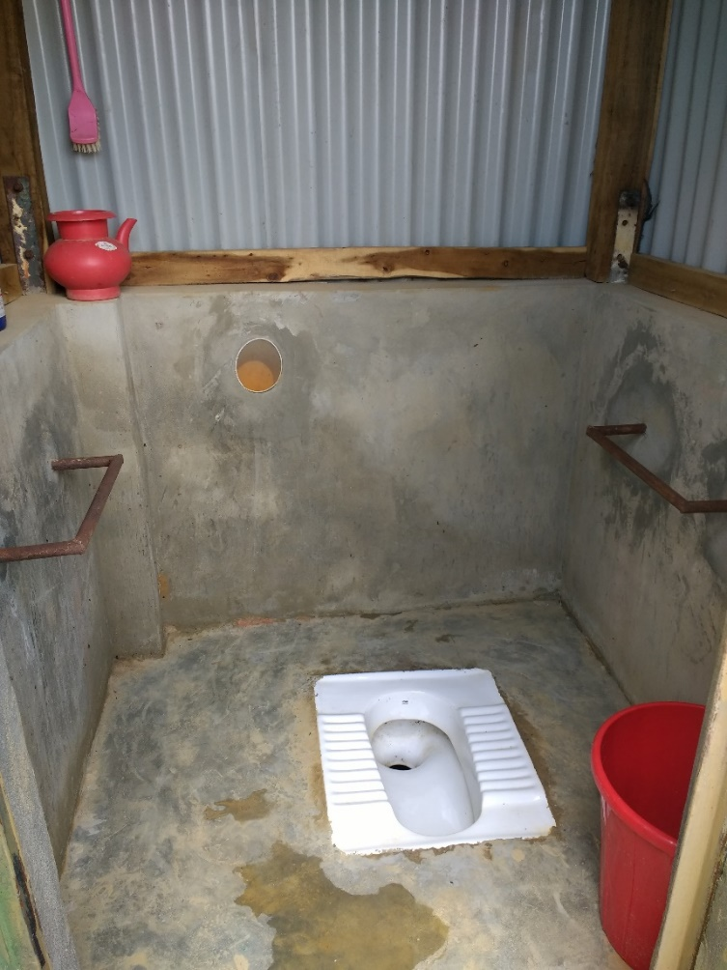
Introduction: Protection, Gender and Inclusion (PGI) in WASH

Slide 2
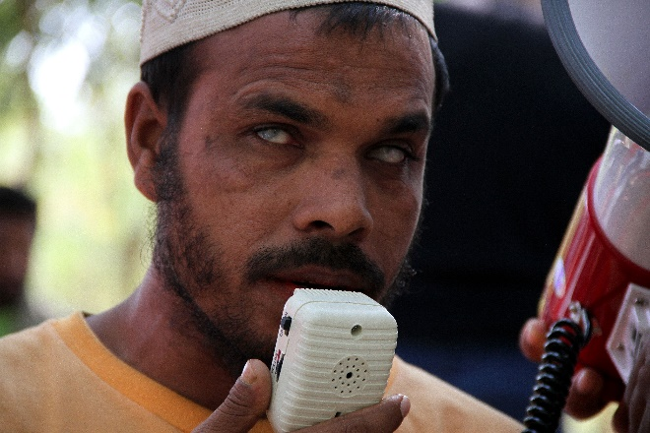
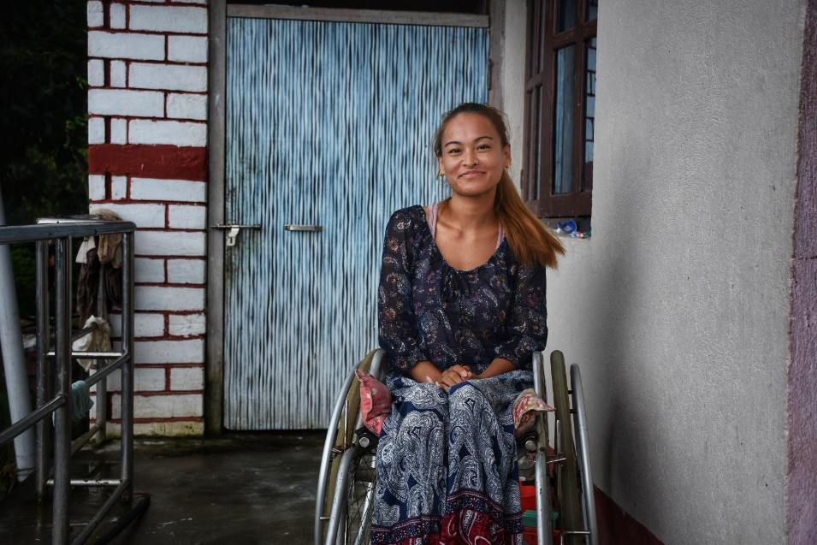
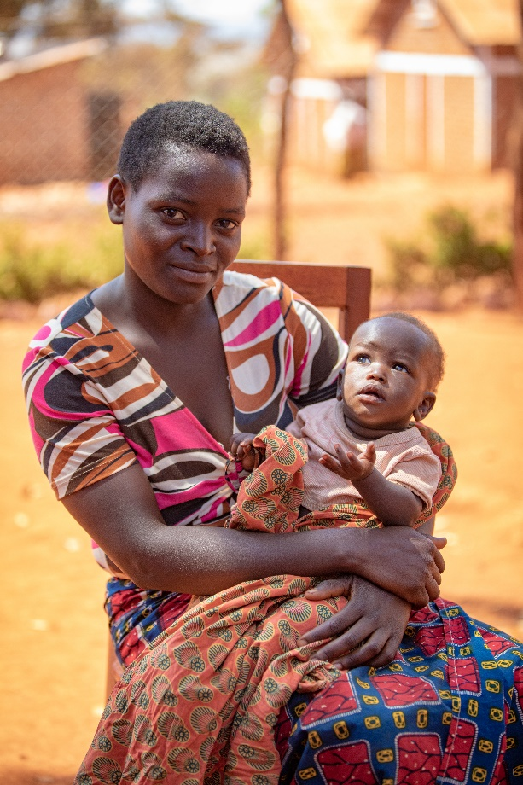
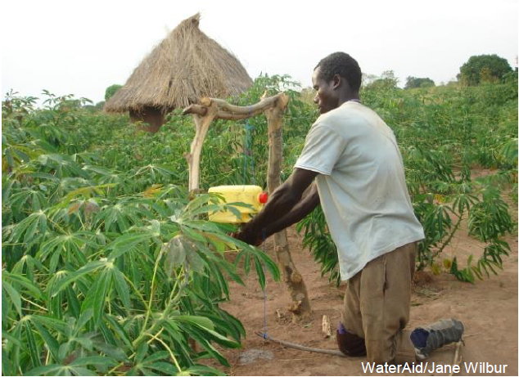
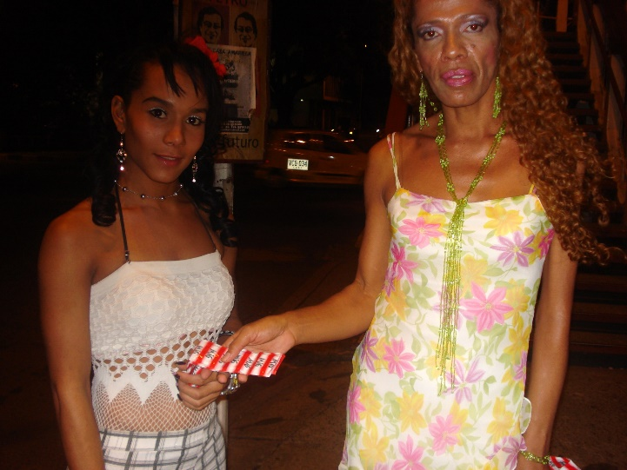
One size does not fit all
Age
Gender
Disability
Ethnic origin
Social background
Religious beliefs
Language
Etc…
Notes:
A 2014 report from Handicap International (now known as Humanity &Inclusion) andHelp Age foundthat 22% of Syrian refugees in camps in Lebanon and Jordan had disability. Moreover,30% of the refugees in these camps had special needs related to age, disability, injuries or chronic disease.
Today we’re not going to go so much into the terminology - we really wanted to keep it a practical session, and focussed on emergency sanitation.
About physical access to WASH facilities – but also being able to understand information (e.g. HP activities), being able to participate and being consulted, and feeling safe and not put at risk of violence by using latrines.

Slide 3

What is PGI?
Notes:
Gender refers to the social differences, rather than biological differences between men and women
Gender relates to the attitudes, behaviors, roles and expectations put on men and women as a result of being male or female.
When we speak of ‘Gender’ we do not just mean women or girls.

Slide 4
Why is this important?
Notes:
There is not a unique solution for everyone
Water, sanitation and hygiene as basic human rights
Equal opportunities as a fundamental human right, associated with non-discrimination
If people are not using the latrines – this is a huge waste of resources, time and energy - we are not doing our job properly!

Slide 5


What does it mean?
Everyone has access to water and sanitation facilities and the items they need to be able to manage their personal and household WASH needs in a way they want to, in accordance with their cultural context, and which supports their feelings of confidence, wellbeing and self-esteem. Adequate water and private facilities for personal hygiene (including menstrual hygiene and incontinence) and maintaining cleanliness (including of children, persons with disabilities, older people and people with chronic illnesses) are vital for safeguarding the dignity of individuals.
Dignity
WASH facilities, services and information are designed and implemented in a way so that everyone can use them, understand them and benefit from them. Cultural stereotypes and norms around gender, age and disability affect decision-making arrangements, and access to power, resources, public participation and even to water itself, and need to be considered in all phases of WASH programmes.
Access

Slide 6


What does it mean?
Everyone in a community – regardless of their gender, age, disability or background – has their voice heard and is actively involved in decision-making for the selection, design, construction and ongoing operation and maintenance of WASH facilities and services.
Participation
Everyone feels comfortable and safe to use WASH facilities and services, and that their design, location and operation minimizes risks of violence. Vulnerability to violence is increased by a lack of safe and secure sanitation infrastructure, particularly in emergency contexts where there can be lack of privacy, overcrowding and lack of lighting in communal spaces and facilities.
Safety

Slide 7
Different barriers to WASH; different solutions
One example - An older man from an ethnic group, with a physical disability
Dignity: Path to the latrines is slippery. He uses a bucket which is embarrassing and stressful
Access: He is partially deaf and finds it hard to understand information from volunteers.
Participation: People from his ethnic group are not invited to join the WASH committee (but he has good ideas)
Safety: Physical safety from slippery paths. He cannot understand main language well to complain or feedback. Risk of verbal abuse.
Notes:
An older man from an ethnic group, with a physical disability - may face barriers because of his social status, disability and age. DAPS can have overlaps!
It is about more than just gender/women, and physical disabilities.
Think about how people get information (e.g. language, hearing ability, who they trust, if target group has phones or listens to radio or reads the newspaper etc.), who makes decisions around hygiene (household spending, community WASH facilities etc.),
Physical, social, cultural and economic barriers all need to be considered together, and their compound effects understood and addressed, through WASH programming which leaves no one behind or unsafe, and does no harm.

Slide 8
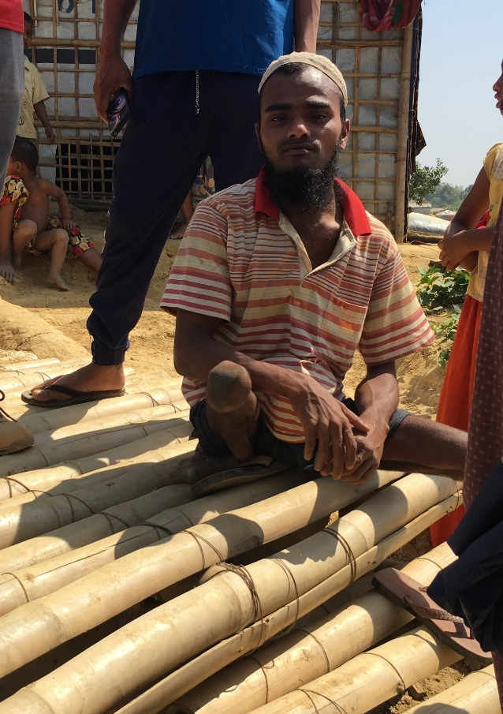
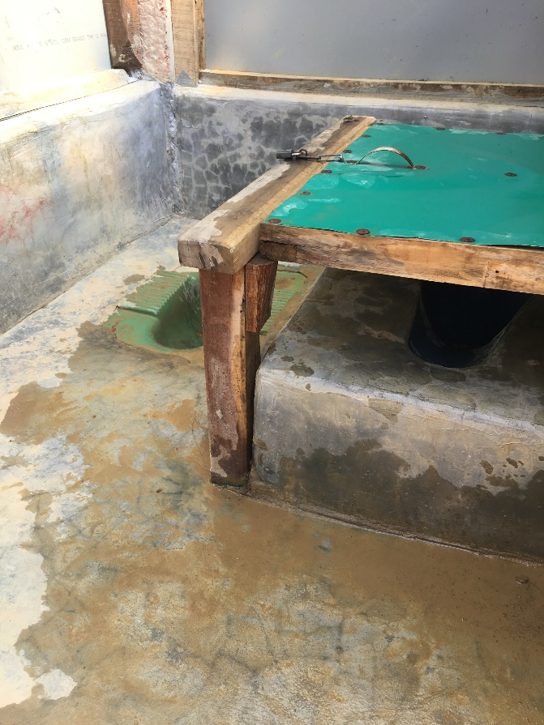
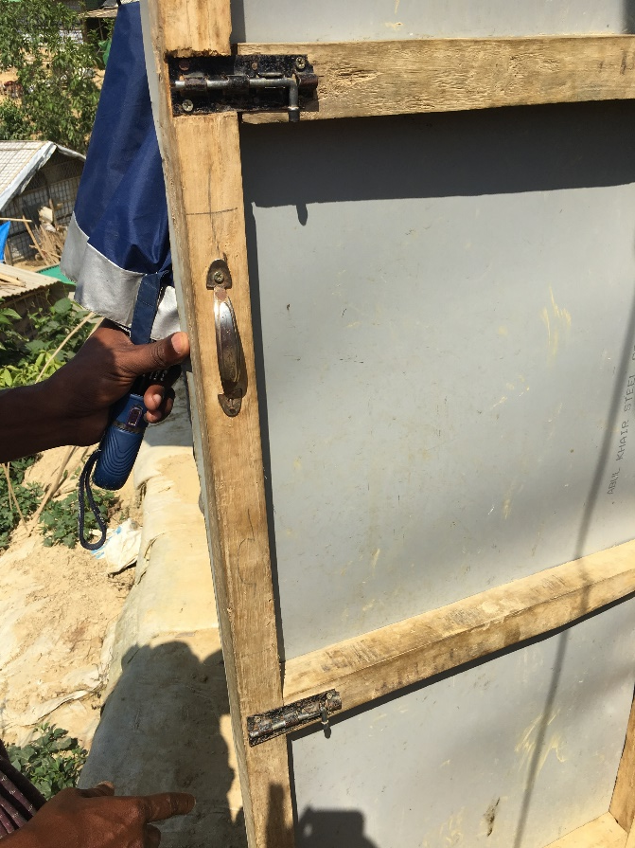
Example: Disabled Friendly Latrine in Cox’s Bazar

Slide 9
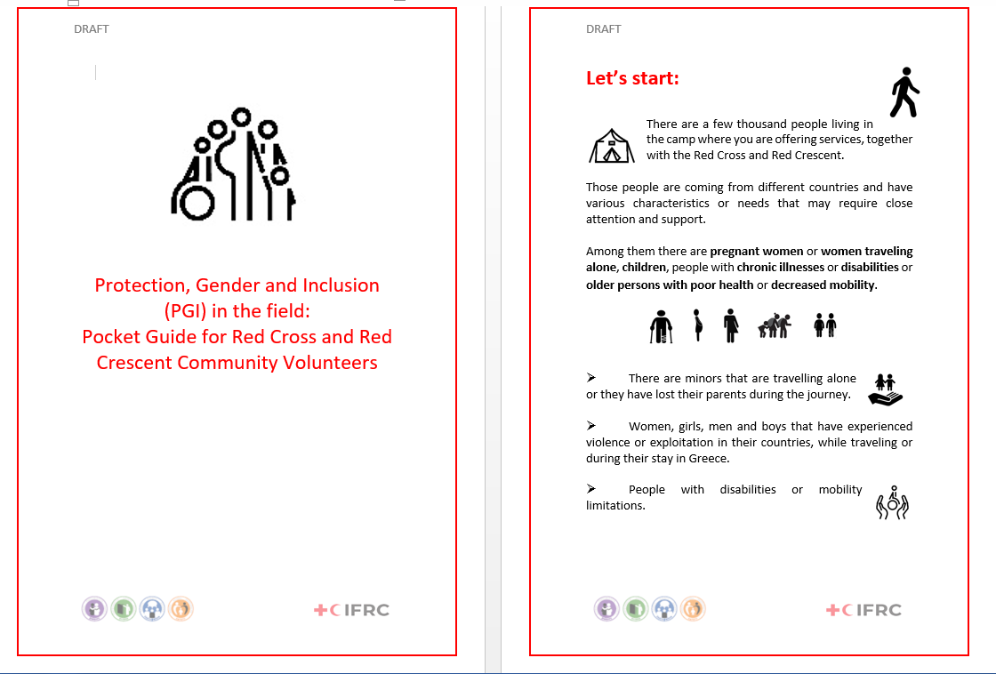
Example from Lesbos
HP volunteers in the community see, or are told about violence or trafficking – what should they do?
It is not HP’s role to help or “solve the problem”
“PGI pocket guide” for people with no knowledge of PGI – tells them where to refer people for help
Translated to 5 languages, PGI team did ½ day training for HP volunteers
Notes:
Example from Lesbos – WASH involved in referral for PGI

Slide 11
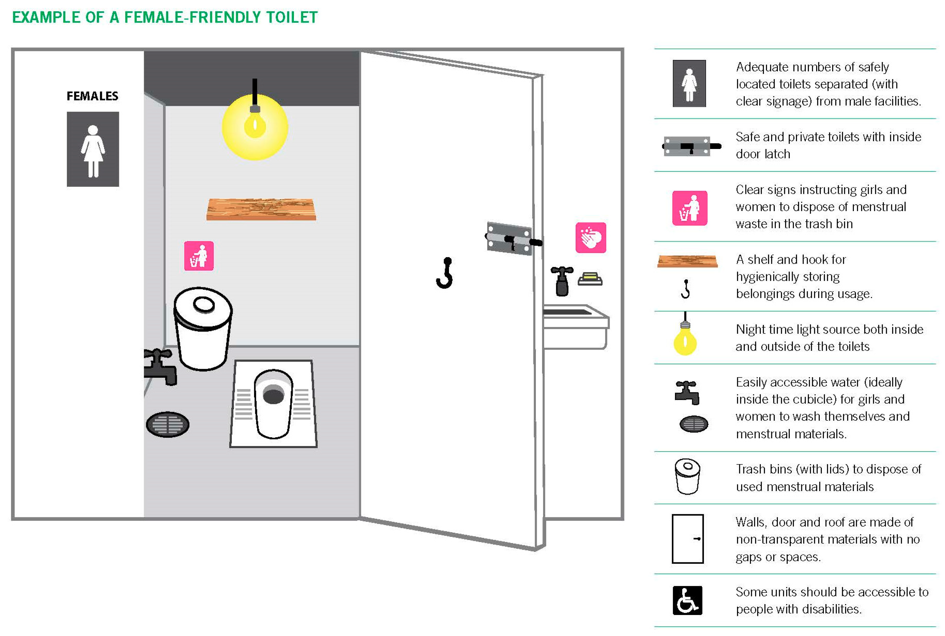
Notes:
IFRC have minimum standards for WASH facilities – it is a simple observation checklist that you can use when you design latrines e.g. have you thought about locks, privacy, access for people with mobility issues, menstrual hygiene, etc.
HANDOUT – explain that we will be doing an exercise using this checklist on Tuesday morning. Their homework is to read through it.
OPTIONAL:
Explain that Oxfam have an initiative called “SaniTweaks” that has initially began with research into if lighting in and around latrines in refugee camps affected SGBV – and they have produced a lot of resources around Best Practices in emergency sanitation
Watch the video:
Best practices in emergency sanitation – OXFAM SaniTweaks
https://youtu.be/emern6grR00
Recap/summarize briefly on key points from the video.

Slide 12
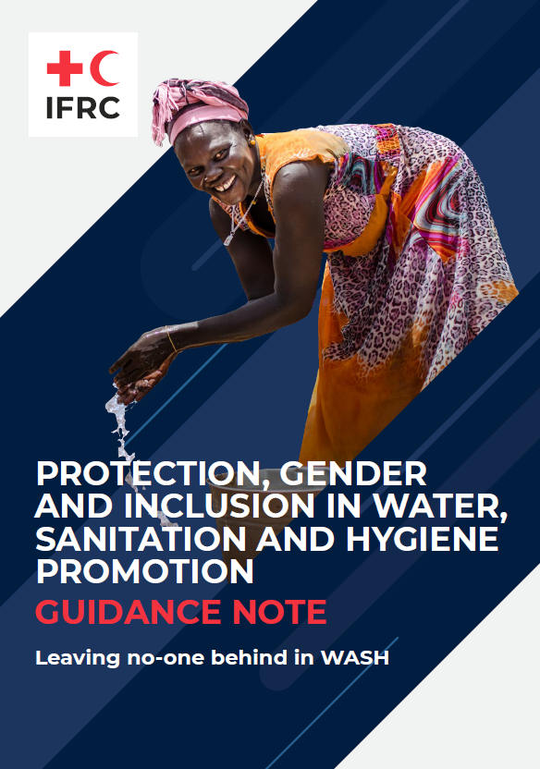
Keen to know more?
https://watsanmissionassistant.org/gender-and-wash/
https://www.ifrc.org/document/minimum-standards-pgi-emergencies
Notes:
https://watsanmissionassistant.org/gender-and-wash/
Highlight the “Questions to ask yourself” tool – use this to reflect if PGI and CEA aspects are well included in your WASH programming/operation.

