Slide 1
Cholera & Oral Rehydration Therapy ORP Operator Manual
Notes:
Register participants
Official opening and recitals

Slide 2
Key Information for a Community ORP Volunteer
p. 3-11
1 – ORP
What is an ORP (Oral Rehydration Point), ORP site selection and set up checklist, ORP floor plan, Daily ORP operation
2 – TREATMENT
Assessing the level of dehydration of AWD/Cholera patients, Decision Flow Chart for treatment and referral, Referral, Home Treatment, How to prepare Oral Rehydration Solutions (ORS) and clean water
3 – IPC
How to prepare Chlorine solutions, Infection Prevention and Control at the ORP
4 – CHOLERA PREVENTION
Cholera prevention messages to give to patients when sending them at home
5 – REPORT
Key information of patients seen to send daily
p. 11- 23
p. 24- 31
p. 32-33
p. 34

Slide 3
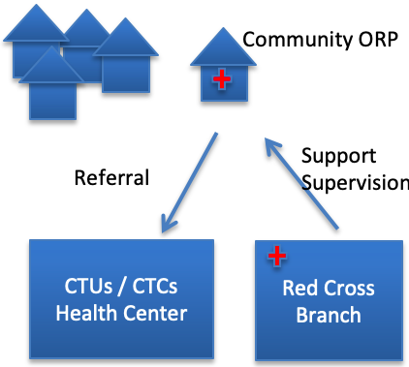
1. What is an ORP (Oral Rehydration Point)
ORP
An ORP is the entry point at the community level for diarrhoea / cholera treatment of mild cases with Oral Rehydration Solutions (ORS) and referral of severe / at risk cases.
NB: ORPs do not replace cholera treatment centers or units. ORP is meant to procure early access to Oral Rehydration Therapy and early referral to cholera treatment centers/units.
Main Functions:
Encourage early care-seeking behavior.
Assess dehydration in diarrhoea patients.
Provide home treatment for mild cases.
Refer patients with dehydration
to CTUs/CTCs.
Refer other at-risk patients.
Give cholera prevention messages.
Report on number of patients seen.
3

Slide 4
1. What is an ORP (Oral Rehydration Point)
ORP
An ORP is a visible (flagged) structure deployed during cholera outbreaks in cholera affected areas – with access to water and a latrine - opened 12 hours a day, and operated by 4-6 ORP operators.
Information to give to community members about Oral Rehydration Points
Oral Rehydration Points are places where people with diarrhoea can seek advice.
Volunteers from Oral Rehydration Points will check your dehydration status and provide you with some ORS (Oral Rehydration Solutions) sachets and ORS to drink at the ORP.
They will advise you if you should go to a health centre or Cholera treatment centre.
They will provide you with health and hygiene messages.
4

Slide 5
1. ORP site selection and set up checklist
ORP
ORP SET UP
Clear entry with Handwashing station.
Observation area with patient chair(s).
Table with clean water and ORS preparation and storage, registration / IEC materials.
Area for safe storage.
Black buckets for vomiting.
White Buckets for chlorine solutions.
Cups and Jugs for drinking ORS.
Bin for waste disposal (+ bin liners).
Latrine.
Area for laundry / dish washing.
SITE SELECTION
Site must be chosen by or agreed by the community.
Accessible but not in a too busy area (market places not recommended).
With access to a nearby water source.
With a nearby latrine or an area where a simple pit latrine could be erected.
Be in a shaded area and protected from rain.
Be in a safe area.
With clear indications and with RC identification (RC flag).
5

Slide 6
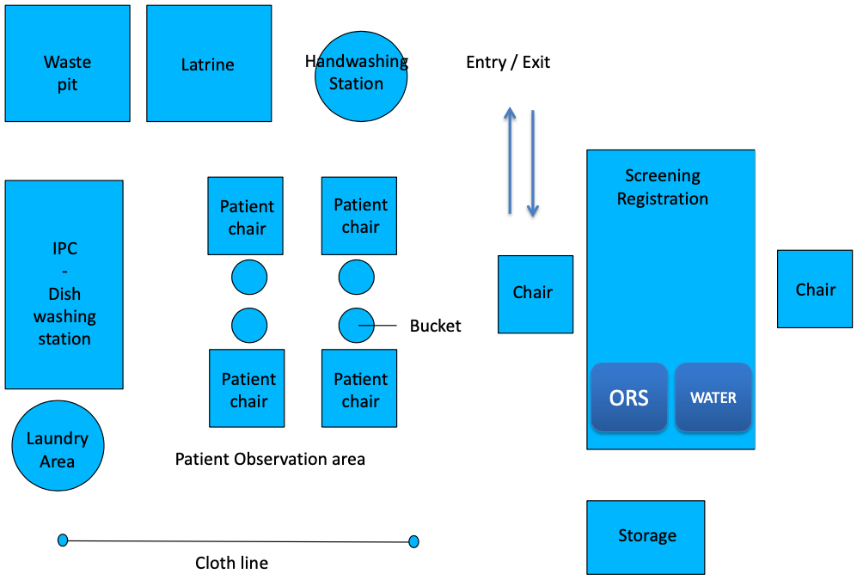
1. ORP Floor Plan (example)
ORP
6

Slide 7
1. Daily ORP Operation
ORP
BEFORE OPENING THE ORP (MORNING)
Fill water filter (preferably night before so it can filter through the night).
Put on your PPE.
Prepare handwashing station.
Clean table and chairs.
Organize ORS, drinking water, clean cups, jug for mixing, and spoons and syringe for giving ORS to small children.
Prepare ORS and drinking water.
Prepare Registration book and IEC materials for cholera awareness.
Prepare vomit buckets.
Prepare chlorine solutions.
Place a bucket for cleaning used cups in the cleaning area.
Set up bin for rubbish collection.
Make sure latrine is clean.
7

Slide 8
1. Daily ORP Operation
ORP
DURING OPENING HOURS
PATIENT MANAGEMENT
Greet visitors. Tell them who you are & what the ORP is for - Wash hands.
Make a quick diagnostic and fill out the ORP register.
Refer to CTC/CTU or settle the patient in to make sure patient can drink ORS.
Give ORS to drink – Explain what is ORS, what ORS is for.
Explain how ORP is organized / rules at the ORP.
Give information about home treatment: (see Home Treatment, and details about the information to give before sending a patient at home).
Give home prevention messages before referring or sending back home.
+ GIVE ORS SACHETS FOR 3 DAYS
+ If included in the response, also give household disinfection kits or hygiene kits
8
Notes:
Screening - Admission
Rapid evaluation of patients (is he a cholera case? Degree of dehydration)
Decides Home treatment or Referral
Register Patient
Settles in the patient
ORS Treatment & Explanations
Explain ORP organization and rules
Give ORS to drink – Explain what is ORS and what ORS is for.
Observation – if not able to drink – Refer.
Explain Home treatment with ORS should continue until diarrhea stops
Explain & show how to prepare ORS
Explain when to drink ORS (daily amount, plus additional amount after loose stool)
Explain how to give ORS (small sips, stop 10 minutes if vomiting before restarting)
Explain how to store ORS, discard at the end of each day - prepare a new solution the next day
Encourage to continue to breastfeed / feed and drink
Explain when to come back at the ORP or go to CTC
If not able to drink ORS
If continuous vomiting or diarrhea
If feeling worse or not improving
If need more ORS
Give key messages for cholera prevention
+ GIVE ORS SACHETS FOR 3 DAYS
+ If included in the response, also give household disinfection kits or hygiene kits
Referral
Explain why patient need to be referred
Make sure patient / caretaker:
Knows where is the nearest CTC/CTU
Understands the need to go quickly to the CTU/CTC
Is given ORS to drink while on his way to the CTU/CTC
Will find a way to reach the nearest health center with family or friends
If not, see with the community if there is a way to support referral
+ GIVE ORS Solution For the transport
+ Referral ticket
Keeping the ORP Clean
Ensure there is enough water available for the day
Prepares chlorine solutions (and discard old chlorine solutions)
Washes floors, surfaces (tables, chairs, etc.) and utensils
Ensure elimination of waste
Regularly Fill water filter (check several times a day)
Wash hands regularly, and especially at critical times
Keep floors clean (clean floors 2x/day or each time it has been soiled with vomit)
Clean chairs between patients
Clean latrines after each use
Verify that already prepared ORS is sufficient or prepare new one
Clean cups, jugs, spoons and syringes regularly
Clean Vomit buckets and have new ones ready with 1cm of 0.2% solution
Verify the level of available chlorine solutions or prepare new one

Slide 9
1. Daily ORP Operation
ORP
DURING OPENING HOURS
ORP MANAGEMENT / IPC
Regularly fill water filter (check several times a day).
Verify that already prepared ORS is sufficient or prepare new one.
Verify that already prepared drinking water is sufficient or prepare new one.
Verify the level of available chlorine solutions or prepare new one.
Wash hands regularly, and especially at critical times.
Keep floors clean (clean floors 2 times/day or each time it has been soiled with vomit).
Clean chairs between patients, remove and clean patient bucket and cups.
Clean latrines after each use.
Clean cups, jugs, spoons and syringes after each patient.
Clean vomit buckets and have new ones ready.
9
Notes:
Screening - Admission
Rapid evaluation of patients (is he a cholera case? Degree of dehydration)
Decides Home treatment or Referral
Register Patient
Settles in the patient
ORS Treatment & Explanations
Explain ORP organization and rules
Give ORS to drink – Explain what is ORS and what ORS is for.
Observation – if not able to drink – Refer.
Explain Home treatment with ORS should continue until diarrhea stops
Explain & show how to prepare ORS
Explain when to drink ORS (daily amount, plus additional amount after loose stool)
Explain how to give ORS (small sips, stop 10 minutes if vomiting before restarting)
Explain how to store ORS, discard at the end of each day - prepare a new solution the next day
Encourage to continue to breastfeed / feed and drink
Explain when to come back at the ORP or go to CTC
If not able to drink ORS
If continuous vomiting or diarrhea
If feeling worse or not improving
If need more ORS
Give key messages for cholera prevention
+ GIVE ORS SACHETS FOR 3 DAYS
+ If included in the response, also give household disinfection kits or hygiene kits
Referral
Explain why patient need to be referred
Make sure patient / caretaker:
Knows where is the nearest CTC/CTU
Understands the need to go quickly to the CTU/CTC
Is given ORS to drink while on his way to the CTU/CTC
Will find a way to reach the nearest health center with family or friends
If not, see with the community if there is a way to support referral
+ GIVE ORS Solution For the transport
+ Referral ticket
Keeping the ORP Clean
Ensure there is enough water available for the day
Prepares chlorine solutions (and discard old chlorine solutions)
Washes floors, surfaces (tables, chairs, etc.) and utensils
Ensure elimination of waste
Regularly Fill water filter (check several times a day)
Wash hands regularly, and especially at critical times
Keep floors clean (clean floors 2x/day or each time it has been soiled with vomit)
Clean chairs between patients
Clean latrines after each use
Verify that already prepared ORS is sufficient or prepare new one
Clean cups, jugs, spoons and syringes regularly
Clean Vomit buckets and have new ones ready with 1cm of 0.2% solution
Verify the level of available chlorine solutions or prepare new one

Slide 10
1. Daily ORP Operation
ORP
BEFORE CLOSING THE ORP (EVENING)
Clean tables and chairs.
Wash all cups and jugs.
Clean latrine, floors.
Remove the rubbish to the waste area agreed to with the community.
Fill water filter.
Verify how many supplies you have left (ORS, zinc, chlorine, aquatabs) and alert your ORP supervisor if you are running low on something.
Verify that you have registered all cases in the logbook.
Follow up with CTU / ORP supervisor all referred cases.
Prepare your SMS message to report number of cases and send it (or go to a place with signal to send it).
Remove PPE – Wash, disinfect, rinse, and hang to dry.
10

Slide 11
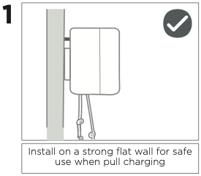
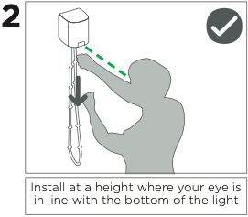
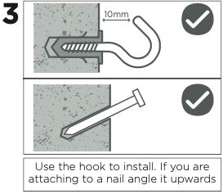
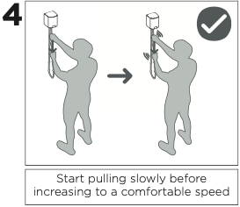
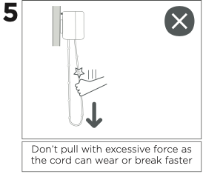
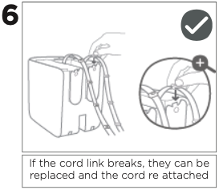
1. How to safely pull charge the nowlight
ORP
Phones can also be charged with nowlight thus ensuring the sending of the SMS
https://deciwatt.global/support/nl01
11

Slide 12
2. Assessing the level of dehydration of AWD/Cholera patients
To assess the level of dehydration use this routine:
TREATMENT
ASK – LOOK – FEEL
Ask about diarrhea: Watery (3 times a day), today ? Since when ?
Ask about thirst ? About urine (normal or very little)
Ask if he/she was able to eat/drink/breastfeed at all today ? Or vomiting ?
Look general condition: Is the person awake and can he/she speak to you? Can he/she walk? Or is he/she very weak ?
Look for sunken eyes (that go inside)
Look at the mouth/tongue – Are they dry ?
Feel. Pinch skin and see if it goes back to normal
12
Notes:
What happened to the child?
How many times a day has the child toilet watery poopoo?
How many days has the child‟s stomach been running?
Is the poo poo bloody or slippery?
Is the child able to drink or breastfeed? (Offer child breast or older child clean water in cup.)
Is the child eating?
Is the child vomiting? How many times in one day?

Slide 13
2. Decision Flow Chart for treatment and referral
Does the patient have diarrhoea?
Diarrhoea is defined as three or more loose stools within 24 hours
Provide hygiene promotion messages and information about cholera. Send home
No
TREATMENT
Yes
Does the patient have diarrhoea since more than two weeks?
Refer to a health centre
Yes
Step 1
Does the patient fit the AWD/Cholera case definition?
No
Is there blood in the stool?
Refer to a health centre
Yes
No
Potential AWD/Cholera case, proceed with dehydration assessment
13

Slide 14
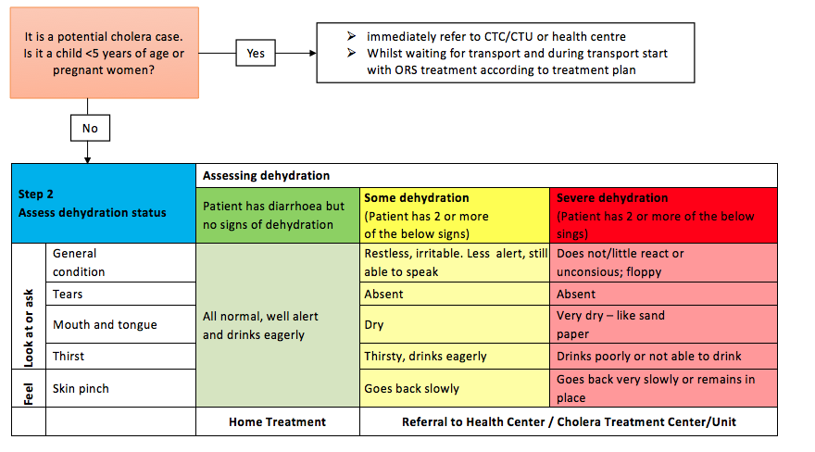
2. Decision Flow Chart for treatment and referral
TREATMENT
14

Slide 15
2. Referral
TO REFER:
All children under 5 years (even if no dehydration).
All Pregnant women (even if no dehydration).
All patients with severe or even some dehydration.
Bloody/mucous diarrhea cases (Refer to Health Facility).
Persistent diarrhea cases, more than 2 weeks (Refer to Health Facility).
Patients not able to drink ORS.
Patients with continuous vomiting or diarrhoea.
Patients who are not improving.
All cases you are worried about.
MAKE SURE PATIENT / CARETAKER:
Knows where is the nearest cholera treatment center (CTU/CTC).
Understands the need to go quickly to the CTU/CTC.
Is given ORS to drink while on their way to the CTU/CTC.
Will find a way to reach the nearest health center with family or friends.
If not, see with the community if there is a way to support referral.
TREATMENT
15

Slide 16
2. Amount of ORS to drink during transport
For referred patients
Patients should drink ORS while waiting for transport / during transport to CTC.
Only patients able to drink – never try to rehydrate unconscious patients.
Mothers should continue to breastfeed while going to the CTC.
TREATMENT
Amount of ORS to drink during transport to the health center or CTC/CTU
Age | ORS to drink per hour
0 to 6 months | 50 – 150 mL per hour
6 months to 2 years | 150 – 200 mL per hour
2 years to 5 years | 200 – 300 mL per hour
5 years to 15 years | 400 – 500 mL per hour
More than 15 years | 1000 mL per hour
50 ml = ¼ cup 100 ml = ½ cup 200 ml = 1 cup
Adapted from Médecins Sans Frontières. Management of a cholera epidemic. 2017 edition.
16

Slide 17
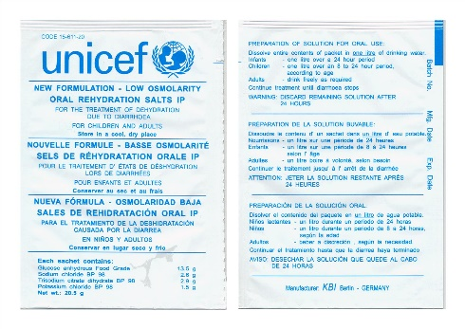
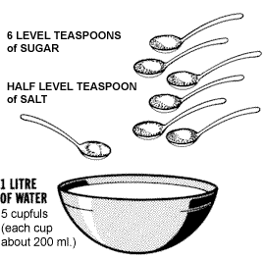
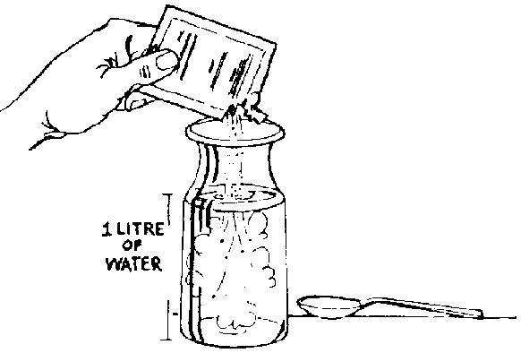
2. How to prepare Oral Rehydration Solution
If the general condition of the individual is normal, is well alert, and drinks eagerly give
him/her ORS, show how to prepare ORS and send him/her home with some advice.
WASH your hands with Soap and clean water.
WASH container and utensil with soap and clean water.
Put 1 Liter of treated water in a clean container.
TREATMENT
Home – made ORS Solution
Already Prepared Powder – ORS Sachets
1 Liter Safe WATER
1 ORS Sachet
1 Litre
of
Treated
Water
Treated
Water
17
Notes:
Schema de ORS – Préparation d’une solution Sucrée Salée – ou a partir d’un sachet d’ORS

Slide 18
2. Protocol for Home Treatment – No dehydration
How much ORS should a person drink?
TREATMENT
50 ml = ¼ cup 100 ml = ½ cup 200 ml = 1 cup
Give ORS for 3 days (3 sachets for children from 5 to 10 years old, 6 sachets for more than 10 years old and adults).
Explain / Show how to prepare ORS at home.
Explain to discard old ORS solution after 24h (at the end of the day) and prepare a new the next day.
Ask to come back if not improving or not able to drink/eat.
18

Slide 19
2. Preparation of Oral Rehydration Solution
Key messages for ORS preparation:
Always wash your hands before handling ORS.
For every person use a clean cup to serve ORS.
Clean the used cups, spoons and jars regularly.
Do not dilute or concentrate ORS – always follow the concentration mentioned in the sachet. If the sachet is for 1 litre, prepare 1 litre even if you use only ½ litre of ORS.
Store ORS in a clean, covered/closed container in the shade.
Do not keep mixed ORS solutions for more than 24 hours.
Throw away any mixed ORS solutions after 24 hours and prepare fresh one.
TREATMENT
19

Slide 20
2. Consumption of Oral Rehydration Solution
Key messages for ORS consumption:
Wash your hands before providing someone ORS.
ORS should be given regularly in small amounts / small sips out of a cup or spoon.
If someone vomits, wait 10 minutes and continue to give ORS but more slowly.
If vomiting continuous or you feel more sick consult to a health facility.
If diarrhoea continues consult to a health facility.
If no ORS is left come back to the ORT volunteer.
If a child is breastfed, continue breastfeeding and make sure that also the mother drinks a lot. Wash hands before breastfeeding.
Juices or mashed bananas can be added to make ORS taste better – whatever someone adds, it is important to make it in a hygienic manner – wash your hands before handling ORS.
Stop drinking ORS when diarrhoea stops.
Never force any liquid in a person that is unconscious – nor adults nor children!
TREATMENT
20

Slide 21
2. Home Treatment
Information to give before sending a patient & caregivers back home
What is ORS (=water/salt/sugar + electrolytes) to facilitate rehydration.
Need to drink ORS until diarrhoea stops – ORS does not prevent or treat diarrhoea.
How to prepare ORS sachets or Home-made ORS.
Need to prepare ORS with clean hands & clean water at home.
When to give ORS (daily amount, plus additional amount after loose stool).
How to give ORS (small sips, stop 10 minutes if vomiting before restarting).
How to store ORS and discard at the end of each day - prepare a new solution the next day.
Raise the importance of continue to breastfeed / feed and drink often.
When to come back at the ORP or go to CTC.
If not able to drink ORS / not eating / not breastfeeding.
If continuous vomiting or diarrhea.
If feeling worse or not improving.
If need more ORS.
Key messages for cholera prevention.
+ GIVE ORS SACHETS FOR 3 DAYS
(3 sachets for children, 6 sachets for older than 10 years and adults)
TREATMENT
21
Notes:
Schema de ORS – Préparation d’une solution Sucrée Salée – ou a partir d’un sachet d’ORS

Slide 22
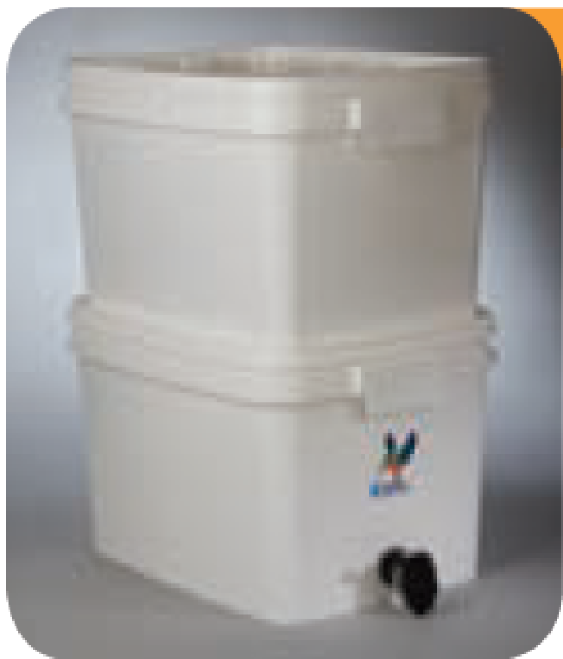
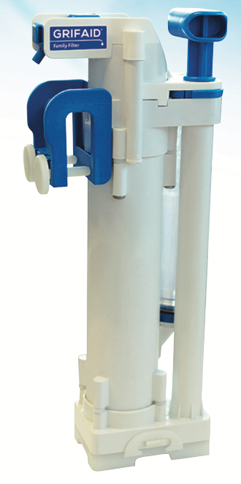
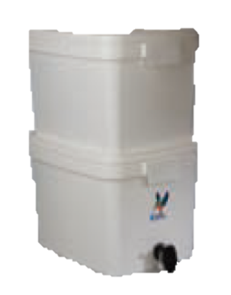
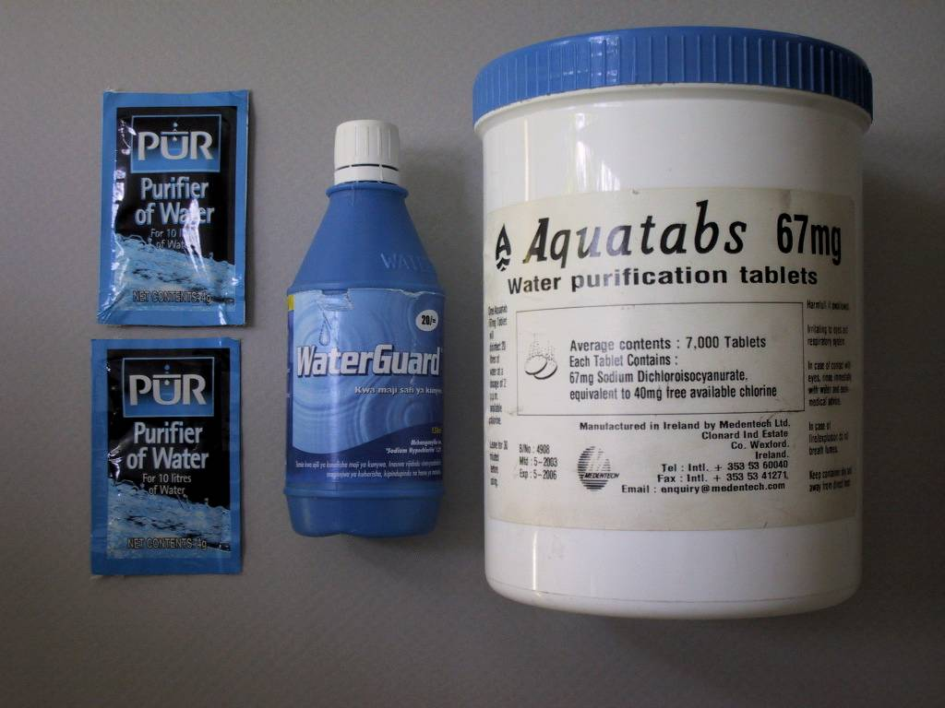
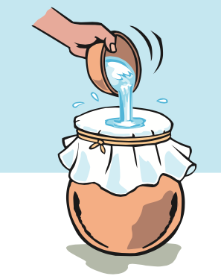
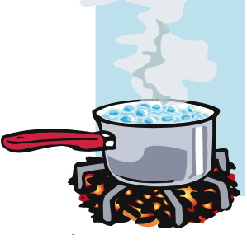
2. How to prepare Clean Water for ORS
Use of chemical water treatment products (aquatabs, bleach, chlorine, PUR, etc.)
TREATMENT
Use of a water filter
Filtering (straining) & Boiling (1 minute)
Always use water than has been properly treated for the preparation of ORS
+
22
Notes:
Schema de ORS – Préparation d’une solution Sucrée Salée – ou a partir d’un sachet d’ORS

Slide 23
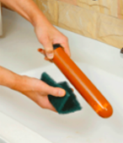
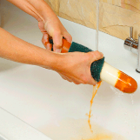
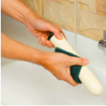
2. Ceramic candle water filter use and maintenance
Remember! The filter can produce only two litres of water per hour, so make sure to regularly fill up the top part of the filter.
Remember as well to fill up the filter every evening when closing the ORP.
The filter provides clean and safe water without having to add chemicals. This means the water has no special taste which is more accepted by people.
TREATMENT
Cleaning of the filter:
Wash your hands with water and soap.
Empty the water filter.
Unscrew the ceramic candle filters.
Hold the filter candle in a bowl of clean water or under running clean water. To avoid contamination of the open-ended plastic threaded mount, take care to ensure that the mount is always clear of the water (see picture).
Take a lightly abrasive pad (included in the kit) in one hand and cup it around the circumference of the filter candle at the top, next to the mount.
Press gently onto the candle surface with the abrasive pad whilst quickly turning the filter candle with the other hand. Do not rub the ceramic surface too aggressively. Never use soap or detergent to clean the candle.
Apply a gentle, even pressure with the pad slowly working down the length of the filter until it is clean.
Clean both containers with clean water and soap – rinse well with clean water.
Place ceramic candle filters on their place.
Add water to the filter.
23

Slide 24
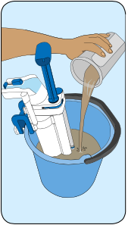
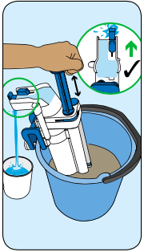
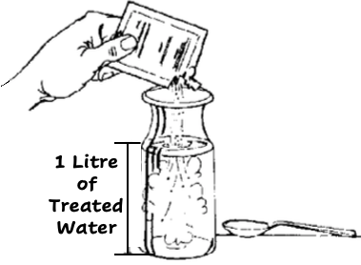
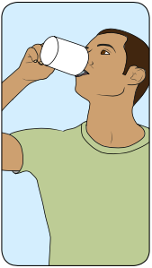
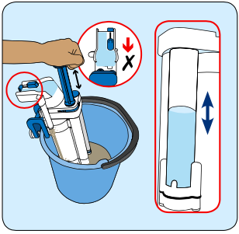
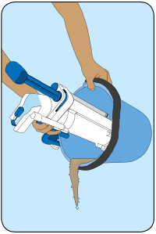
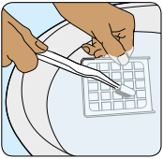
2. GRIFAID filter use and maintenance
DRINK
Use this
water to
prepare ORS
1. Fill the bucket with cloudy/dirty water
2. Place the Grifaid filter in the water and fix the filter to the bucket using the integrated clamp. Slide open the tap and pump
3. Collect the clean and safe water in a clean container
TREATMENT
Drink
Safe
ORS
Remember to treat this water if it will be stored!
CLEAN
Every time
the bucket
is nearly empty
Clean the gauze:
Remove and wash in clean water
Close the tap.
With water still covering the filter base, pump SLOWLY 10 times
See clean water move up
and down in the tube and
unfiltered water coming out
Discard remaining water
24

Slide 25
3. Hand Hygiene
Hand Hygiene for staffs
On entering the ORP.
Before preparing ORS solutions, or giving ORS to drink to a patient.
Before eating, drinking (or smoking).
After handling soiled laundry, waste, cleaning spills or emptying excreta buckets.
After contact with vomit or any other body fluids.
After going to the toilets.
On leaving ORP.
Hand Hygiene for Patients / Attendants
On entering the ORP.
Before drinking ORS or giving ORS to drink.
Before eating (or smoking).
Before preparing food for a patient.
After contact with vomit or any other body fluids.
After handling soiled laundry.
After going to the toilets.
On leaving ORP.
IPC
25
Notes:
Schema de ORS – Préparation d’une solution Sucrée Salée – ou a partir d’un sachet d’ORS

Slide 26
3. Personal Protective Equipment
Basic PPE – Personal Protective Equipment for ORP staff
Short-sleeved top + 1 pair of trousers (locally procured is fine).
1 pair of boots.
Staff change on entering and leaving the ORP. Staff must neither leave the ORP in their protective clothing nor work in the ORP in their personal clothes.
Additional PPE
Reusable rubber gloves.
Reusable plastic apron.
Reusable face shield.
For the preparation of chlorine solutions; collection, transport and washing/disinfection of soiled laundry or materials, dishes; for elimination of wastewater, feces, vomit, and waste.
NB: Respiratory masks (FFP 1, 2 or 3) protect against dust (e.g. removing
ashes, sweeping the waste storage area) but not against gases or vapours. Cholera is not transmitted by the inhalation of droplets. It is pointless to wear a surgical mask
or FFP2 respirator to protect oneself against cholera.
IPC
26
Notes:
Schema de ORS – Préparation d’une solution Sucrée Salée – ou a partir d’un sachet d’ORS

Slide 27
3. General Principles for cleaning surfaces and items
First
Second
Third
WASH / CLEAN
RINSE
DISINFECT
IPC
ONLY CLEAN ITEMS CAN BE EFFICIENTLY DISINFECTED
NB : IF NOT CLEAN – CHLORINE WILL REACT WITH ORGANIC MATER RATHER THAN WITH MICROBES
27

Slide 28
3. How to prepare Chlorine Solutions with 1g Aquatabs
IPC
This solution can be prepared weekly if stored properly
28

Slide 29
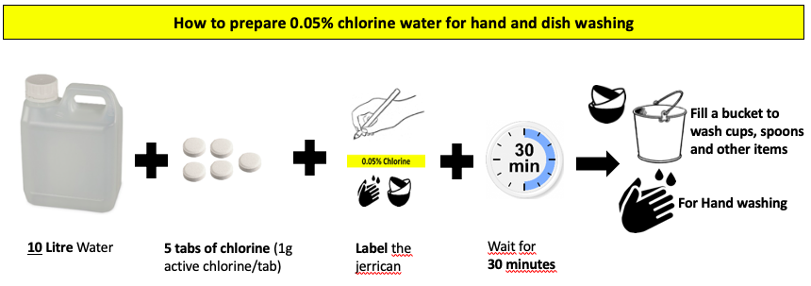
3. How to prepare Chlorine Solutions with 1g Aquatabs
IPC
Prepare this solution daily
29
Prepare this solution daily

Slide 30
3. How to prepare solutions with other chlorine products
Chlorine Solutions | Solution 0,05% | Solution 0,2% | Solution 2%
Uses | Handwashing, washing clothes, utensils, dishes | Disinfection of shoes, floors, beds, chairs, footbaths | Feces, vomit
How often to prepare solutions | Daily | Daily | Weekly if stored properly
Aquatabs (NaDcc 1g/tablet) | 5 tablets / 10L | 20 tablets / 10L 2 tablets / 1L | 20 tablets / 1L
Bleach (5% active chlorine) | 100 mL / 10L 10 mL / 1L | 400 mL / 10L 40 mL / 1L | - 400 mL / 1L
HTH (70% active chlorine) | 0.7 g/L ½ tablespoon / 10L | 3 g/L 2 tablespoon / 10L | 30 g/L 2 tablespoon / 1L
Make your own recipe
IPC
30
http://icrc-chlorine-app.westeurope.cloudapp.azure.com/dashboard/home
Notes:
Schema de ORS – Préparation d’une solution Sucrée Salée – ou a partir d’un sachet d’ORS

Slide 31
3. Infection Prevention & Control at the ORP
Floors, Surfaces and utensils
Wash floors with detergent, rinse and disinfect with 0.2% chlorine solution 2 times a day or each time it is soiled.
Wash surfaces (table, chairs, etc.) with detergent, rinse and disinfect with 0.2% chlorine solution at the end of the day.
After each patient, wash patient chair (with 0,2%), cups, spoons with detergent, rinse, and disinfect with 0.05% chlorine solution.
Vomit buckets
Give a new bucket to each patient with 1 cm of 2% chlorine solution at the bottom in case someone can´t make it to the latrine. This will disinfect the vomit and feces.
Empty the content of the bucket when a third full into the latrine pit.
Rinse the bucket with clean water and disinfect with 0.2% solution.
Waste
Collect and secure waste bags in the waste management area once a day.
Wash dirty bins with detergent, rinse and disinfect with 0.2% chlorine solution.
Eliminate waste (burn or burry).
Clean the waste area.
IPC
31
Notes:
Schema de ORS – Préparation d’une solution Sucrée Salée – ou a partir d’un sachet d’ORS

Slide 32
3. Infection Prevention & Control at the ORP
Latrines
Clean latrines or pits and surrounding areas at least two times a day –once at midday and once in the evening before closing the ORP. If it is dirty clean it more often. Use 2% chlorine solution. Also use 2% solution if someone had to vomit or poo on the floor.
Laundry / staff PPE
PPE is changed every day and each time it is soiled.
Soiled PPE are collected by staff wearing plastic aprons and rubber gloves;
Washed separately with soap and water or with detergent available on the local market, rinsed in clear water, soaked in 0.05% chlorine solution for 15 minutes, rinsed in clear water again and hung out in the sun until completely dry.
Disinfection of shoes (optional)
Foot bath are not recommended.
Spraying with 0.2% chlorine solution the shoe sole at the exit of the ORP.
NB: The effectiveness of this measure in stopping the spread of vibrio cholerae in and outside an ORP or a CTC has not been demonstrated. However shoe disinfection points can serve to raise awareness among patients/attendants on the need for exceptional measures related to the contagious nature of cholera.
IPC
32
Notes:
Schema de ORS – Préparation d’une solution Sucrée Salée – ou a partir d’un sachet d’ORS

Slide 33
4. Cholera Prevention
GENERAL PREVENTION MESSAGES
SAFE WATER - Drink safe water : treated (boiled or with added chlorine) and safely stored in clean, covered containers.
HANDWASHING - Handwash with soap at key moments (after defecation; after cleaning a child bottom and disposing of children feces properly; before and after taking care of a sick family member; before preparing food, before eating, before breastfeeding or taking care of a child)
SAFE FOOD HYGIENE - Cook food well, eat it hot, keep it covered, and peel / clean fruits and vegetables. Do not eat in places where you are not sure of food hygiene.
USING LATRINES - Use latrines or bury your feces (do no practice open defecation).
CLEANING UP — Keep utensils & surfaces clean, in latrines, in kitchen and places where your family bathes and washes clothes.
PREVENTION
33

Slide 34
4. Cholera Prevention at home
KEY MESSAGE = Stools, vomit and soiled clothes of cholera patients are highly
contagious and should be handled safely.
DEALING WITH PATIENT FLUIDS
Give vomiting patient a bucket to collect vomit safely.
Dispose vomit bucket content and all spills / soiled water in the latrine pit.
In case of vomit / feces spills, collect them in a bucket and dispose in the latrine pit.
CLEANING THE HOUSE : First – WASH Second – RINSE Third – DISINFECT
Every item that has been soiled must be washed, rinsed then disinfected with bleach.
Cleaning cloths (or soiled clothes) must be:
Washed with water/soap (and soiled water disposed in the latrine pit).
Rinsed.
Soaked in bleach for 15 minutes.
Hang dry in the sun
PREVENTION
LIMITING HOUSEHOLD TRANSMISSION
WASH HANDS with soap carefully after taking care of the patient, or after cleaning items.
WASH HANDS with soap carefully before taking care of someone else.
WASH HANDS and kitchen items carefully with soap before preparing or eating food.
WASH HANDS and containers carefully with soap before preparing ORS / drinking water.
NB: Be careful of where you dispose of contaminated water and where
you wash contaminated cloths/items
34

Slide 35
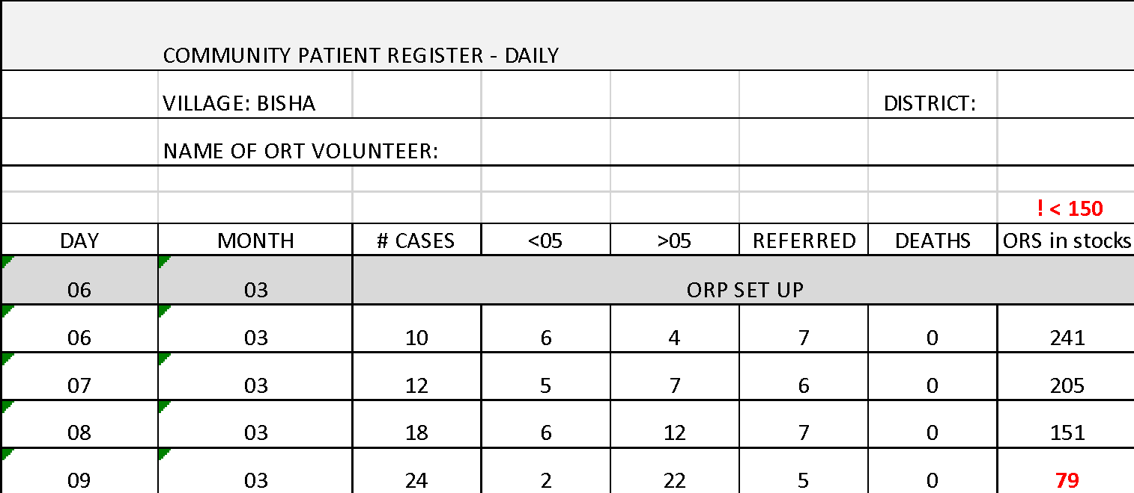
5. Report
BISHA # 0903 # 24 # 02 # 22 # 05 # 00 # 79
Daily SMS Report:
[Name of location] # Day [DDMM] # Total number of cases # cases under 5 # cases above 5
# number of cases referred # number of community deaths # ORS in stock
REPORT
35
Notes:
SMS message should include:
[Name of location] # D [DDMM] # Total number of cases #cases under 5 # cases over 5 # number of deaths from AWD # number of cases referred # ORS in stock # Zinc in Stock
Location: BISHA
Date: 09/03
Total diarrhea/cholera cases: 24
Cases under 5: 2
Cases above 5: 22
Community deaths: 0
Referrals to CTUs/CTCs: 5
ORS sachets in stocks: 79

Slide 36
Write here key contact numbers:
RCRC Branch:_________________________________________________
Supervisor:___________________________________________________
Health Centre:________________________________________________
CTC: ________________________________________________________
CTU: ________________________________________________________
____________________________________________________________
36

Slide 37
ORP Kit Checklist
Quantity | Item
1 | Ceramic filter (Fairey) cartridge
1 | Grifaid Water Filter
4 | Slabs for latrines
5 | Tarpaulins size 4 x 6m
1 | 20m Nylon rope
1 | Table with removable legs
6 | Plastic foldable chairs
1 | ORP Red Cross Flag
1 | Demarcation tape (red and white barrier tape)
2 | Red Cross Tabards
8 | Tubs of NaDCC 1670mg tablets
30 | Stickers for chlorination labelling 0.05%, 0.2% and 2%
1 | Wata Water Tester
1 | Nowlight torch
1 | Birchmeiyer Sprayer 13l backpack
2 | Abus 65/40 padlocks
Quantity | Item
2 | 1 Litre Measuring jugs
10 | 200 ml plastic cups
10 | 500 ml plastic cups
10 | Plastic teaspoons 5ml
10 | 20ml Plastic Spoons
2 | Long Plastic Spoons (40cm)
3 | 10ml plastic syringes
1 | Round 5 litre washing up bowl
8 | 10 litre white buckets
7 | 14 Litre Oxfam Buckets with tap and blue lid
4 | Black plastic lids to go with 10 litre buckets
4 | White plastic lids to go with 10 litre buckets
1 | 25 litre bucket for Grifaid Water Filter
4 | 10 litre Jerry Can (ensure cap is attached)
Quantity | Item
2 | Red Butyl Aprons
1 | Box of 100 Examination gloves
20 | Surgical Masks
2 | Safety goggles
4 | Micropore surgical tape
6 | Bars of soap
20 | Reusable tea towels
1 | Pack of 100 6x8cm plastic bags
50 | 60 litre black plastic bags
2 | 60 litre Garbage bag stands
10 | Pairs of Household Rubber Gloves
2 | Mop heads
2 | Sticks for Mops
5 | Biros (Pens)
2 | Black permanent markers
2 | Red permanent markers
2 | A5 Spiral Notebook

Slide 38
ORP Kit Checklist
Quantity |  | Item
1 |  | Ceramic filter (Fairey) cartridge
1 |  | Grifaid Water Filter
4 |  | Slabs for latrines
5 |  | Tarpaulins size 4 x 6m
1 |  | 20m Nylon rope
1 |  | Table with removable legs
6 |  | Plastic foldable chairs
1 |  | ORP Red Cross Flag
1 |  | Demarcation tape (red and white barrier tape)
2 |  | Red Cross Tabards
8 |  | Tubs of NaDCC 1670mg tablets
30 |  | Stickers for chlorination labelling 0.05%, 0.2% and 2%
1 |  | Wata Water Tester
1 |  | Nowlight torch
1 |  | Birchmeiyer Sprayer 13l backpack
2 |  | Abus 65/40 padlocks
Quantity |  | Item
2 |  | 1 Litre Measuring jugs
10 |  | 200 ml plastic cups
10 |  | 500 ml plastic cups
10 |  | Plastic teaspoons 5ml
10 |  | 20ml Plastic Spoons
2 |  | Long Plastic Spoons (40cm)
3 |  | 10ml plastic syringes
1 |  | Round 5 litre washing up bowl
8 |  | 10 litre white buckets
7 |  | 14 Litre Oxfam Buckets with tap and blue lid
4 |  | Black plastic lids to go with 10 litre buckets
4 |  | White plastic lids to go with 10 litre buckets
1 |  | 25 litre bucket for Grifaid Water Filter
4 |  | 10 litre Jerry Can (ensure cap is attached)
Quantity |  | Item
2 |  | Red Butyl Aprons
1 |  | Box of 100 Examination gloves
20 |  | Surgical Masks
2 |  | Safety goggles
4 |  | Micropore surgical tape
6 |  | Bars of soap
20 |  | Reusable tea towels
1 |  | Pack of 100 6x8cm plastic bags
50 |  | 60 litre black plastic bags
2 |  | 60 litre Garbage bag stands
10 |  | Pairs of Household Rubber Gloves
2 |  | Mop heads
2 |  | Sticks for Mops
5 |  | Biros (Pens)
2 |  | Black permanent markers
2 |  | Red permanent markers
2 |  | A5 Spiral Notebook

