Slide 1

Cholera & Oral Rehydration Therapy
ORP SIGNS AND REFERENCE CARDS
Notes:
Register participants
Official opening and recitals

Slide 2
ORP site selection and set up checklist
ORP SET UP
Clear entry with Handwashing station
Observation area with patient chair(s)
Table with clean water and ORS preparation and storage, registration / IEC materials
Area for safe storage
Black buckets for vomiting
White Buckets for chlorine solutions
Cups and Jugs for drinking ORS
Bin for waste disposal (+ bin liners)
Latrine
Area for laundry / dish washing
SITE SELECTION
Site must be chosen by or agreed by the community
Accessible but not in a too busy area (market places not recommended)
with access to a nearby water source
with a nearby latrine or an area where a simple pit latrine could be erected
Be in a shaded area and protected from rain
Be in a safe area
With clear indications and with RC identification (RC flag)

Slide 3
ORP Floor Plan
Waste
pit
Latrine
Handwashing
Station
Entry / Exit
Screening
Registration
Patient
chair
Patient
chair
IPC
-
Dish
washing
station
Chair
Chair
Bucket
Patient
chair
Patient
chair
ORS
WATER
Laundry
Area
Patient Observation area
Storage
Cloth line

Slide 4

ORP
ORAL REHYDRATION POINT

Slide 5
HAND WASHING
STATION

Slide 6
LATRINE

Slide 7
ORS
ORAL REHYDRATION SOLUTION

Slide 8
DRINKING WATER

Slide 9
REGISTRATION

Slide 10
STORAGE

Slide 11
WASTE

Slide 12
DISH WASHING
LAUNDRY

Slide 13
CHLORINE SOLUTION
0.05%

Slide 14
CHLORINE SOLUTION
0.2%

Slide 15
CHLORINE SOLUTION
2%

Slide 16
Daily ORP Operation
BEFORE OPENING THE ORP (MORNING)
Fill water filter (nigh before so it can filter through the night)
Put on your PPE
Prepare handwashing station
Clean table and chairs
Organize ORS, drinking water, clean cups, Jug for mixing, and spoons and syringe for giving ORS to small children
Prepare ORS and drinking water
Prepare Registration book and IEC materials for cholera awareness
Prepare Vomit buckets
Prepare chlorine solutions
Place a bucket for cleaning used cups in the cleaning area
Set up bin for rubbish collection
Make sure Latrine is clean

Slide 17
Daily ORP Operation
DURING OPENING HOURS
PATIENT MANAGEMENT
Greet visitors. Tell them who you are & what the ORP is for - Wash hands
Make a quick diagnostic and fill out the ORP register
Refer to CTC/CTU or settle the patient in to make sure patient can drink ORS
Give ORS to drink – Explain what is ORS, what ORS is for
Explain how ORP is organized / rules at the ORP
Give information about home treatment: Continue home treatment until diarrhea stops; Quantities of ORS to drink (daily amount + after each loose stool); Drink ORS in small sips; Wait 10 minutes if vomiting and restart drinking ORS in small quantity; Show how to prepare ORS; Explain how to store ORS and discard remaining ORS each day / prepare a new solution the next day; Encourage to breastfeed or feed/drink; Explain when to come back at the ORP or go to CTC: If not able to drink OR, If continuous vomiting or diarrhea, If feeling worse or not improving or If in need of more ORS
Give home prevention messages before referring or sending back home.
+ GIVE ORS SACHETS FOR 3 DAYS
+ If included in the response, also give household disinfection kits or hygiene kits
Notes:
Screening - Admission
Rapid evaluation of patients (is he a cholera case? Degree of dehydration)
Decides Home treatment or Referral
Register Patient
Settles in the patient
ORS Treatment & Explanations
Explain ORP organization and rules
Give ORS to drink – Explain what is ORS and what ORS is for.
Observation – if not able to drink – Refer.
Explain Home treatment with ORS should continue until diarrhea stops
Explain & show how to prepare ORS
Explain when to drink ORS (daily amount, plus additional amount after loose stool)
Explain how to give ORS (small sips, stop 10 minutes if vomiting before restarting)
Explain how to store ORS, discard at the end of each day - prepare a new solution the next day
Encourage to continue to breastfeed / feed and drink
Explain when to come back at the ORP or go to CTC
If not able to drink ORS
If continuous vomiting or diarrhea
If feeling worse or not improving
If need more ORS
Give key messages for cholera prevention
+ GIVE ORS SACHETS FOR 3 DAYS
+ If included in the response, also give household disinfection kits or hygiene kits
Referral
Explain why patient need to be referred
Make sure patient / caretaker:
Knows where is the nearest CTC/CTU
Understands the need to go quickly to the CTU/CTC
Is given ORS to drink while on his way to the CTU/CTC
Will find a way to reach the nearest health center with family or friends
If not, see with the community if there is a way to support referral
+ GIVE ORS Solution For the transport
+ Referral ticket
Keeping the ORP Clean
Ensure there is enough water available for the day
Prepares chlorine solutions (and discard old chlorine solutions)
Washes floors, surfaces (tables, chairs, etc.) and utensils
Ensure elimination of waste
Regularly Fill water filter (check several times a day)
Wash hands regularly, and especially at critical times
Keep floors clean (clean floors 2x/day or each time it has been soiled with vomit)
Clean chairs between patients
Clean latrines after each use
Verify that already prepared ORS is sufficient or prepare new one
Clean cups, jugs, spoons and syringes regularly
Clean Vomit buckets and have new ones ready with 1cm of 0.2% solution
Verify the level of available chlorine solutions or prepare new one

Slide 18
Daily ORP Operation
DURING OPENING HOURS
ORP MANAGEMENT / IPC
Regularly Fill water filter (check several times a day)
Verify that already prepared ORS is sufficient or prepare new one
Verify that already prepared Drinking Water is sufficient or prepare new one
Verify the level of available chlorine solutions or prepare new one
Wash hands regularly, and especially at critical times
Keep floors clean (clean floors 2x/day or each time it has been soiled with vomit)
Clean chairs between patients, remove and clean patient bucket and cups
Clean latrines after each use
Clean cups, jugs, spoons and syringes after each patient
Clean Vomit buckets and have new ones ready
Notes:
Screening - Admission
Rapid evaluation of patients (is he a cholera case? Degree of dehydration)
Decides Home treatment or Referral
Register Patient
Settles in the patient
ORS Treatment & Explanations
Explain ORP organization and rules
Give ORS to drink – Explain what is ORS and what ORS is for.
Observation – if not able to drink – Refer.
Explain Home treatment with ORS should continue until diarrhea stops
Explain & show how to prepare ORS
Explain when to drink ORS (daily amount, plus additional amount after loose stool)
Explain how to give ORS (small sips, stop 10 minutes if vomiting before restarting)
Explain how to store ORS, discard at the end of each day - prepare a new solution the next day
Encourage to continue to breastfeed / feed and drink
Explain when to come back at the ORP or go to CTC
If not able to drink ORS
If continuous vomiting or diarrhea
If feeling worse or not improving
If need more ORS
Give key messages for cholera prevention
+ GIVE ORS SACHETS FOR 3 DAYS
+ If included in the response, also give household disinfection kits or hygiene kits
Referral
Explain why patient need to be referred
Make sure patient / caretaker:
Knows where is the nearest CTC/CTU
Understands the need to go quickly to the CTU/CTC
Is given ORS to drink while on his way to the CTU/CTC
Will find a way to reach the nearest health center with family or friends
If not, see with the community if there is a way to support referral
+ GIVE ORS Solution For the transport
+ Referral ticket
Keeping the ORP Clean
Ensure there is enough water available for the day
Prepares chlorine solutions (and discard old chlorine solutions)
Washes floors, surfaces (tables, chairs, etc.) and utensils
Ensure elimination of waste
Regularly Fill water filter (check several times a day)
Wash hands regularly, and especially at critical times
Keep floors clean (clean floors 2x/day or each time it has been soiled with vomit)
Clean chairs between patients
Clean latrines after each use
Verify that already prepared ORS is sufficient or prepare new one
Clean cups, jugs, spoons and syringes regularly
Clean Vomit buckets and have new ones ready with 1cm of 0.2% solution
Verify the level of available chlorine solutions or prepare new one

Slide 19
Daily ORP Operation
BEFORE CLOSING THE ORP (EVENING)
Clean tables and chairs
Wash all cups and jugs
Clean Latrine, floors
Remove the rubbish to the waste area agreed to with the community
Fill water filter
Verify how many supplies you have left (ORS, zinc, chlorine, aquatabs) and alert your ORP supervisor if you are running low on something
Verify that you have registered all cases in the logbook
Follow up with CTU / ORP supervisor all referred cases
Prepare your SMS message to report number of cases and send it (or go to a place with signal to send it)
Remove PPE – Wash, disinfect, rinse, and hang to dry

Slide 20
Assessing the level of dehydration of Diarrhea/Cholera patients
ASK – LOOK – FEEL
Ask about diarrhea: Watery - 3x/day - since when ?
Ask about thirst - About urine (normal or very little)
Ask if able to eat/drink/breastfeed at all today ? Or vomiting ?
Look general condition: Is the person awake and can he/she speak to you?? Can he/she walk? Or very weak ?
Look at the mouth/tong – dry ?
Look for sunken eyes (that go inside)
Feel. Pinch skin and see if it goes back to normal or slowly (>2 sec)

Slide 21
Decision Flow Chart for treatment and referral (1/4)
Step 1
Does the patient fit the AWD/Cholera case definition?
Does the patient have diarrhoea?
Diarrhoea is defined as three or more loose stools within 24 hours
Provide hygiene promotion messages and information about cholera. Send home
No
Yes
Does the patient have diarrhoea since more than two weeks?
Refer to a health centre
Yes
No
Is there blood in the stool?
Yes
Refer to a health centre
No
Potential AWD/Cholera case, proceed with dehydration assessment

Slide 22
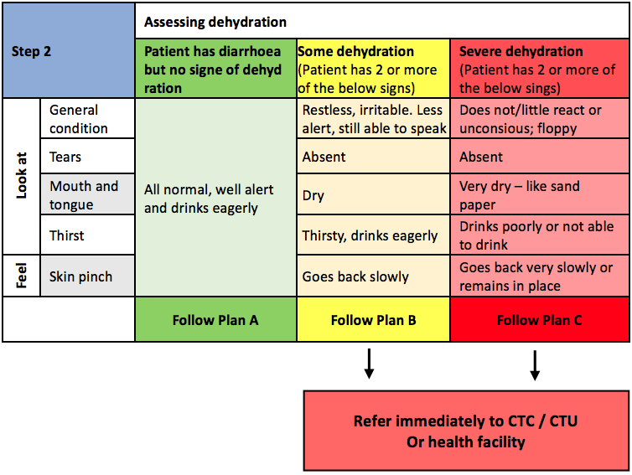
Decision Flow Chart for treatment and referral (2/4)

Slide 23
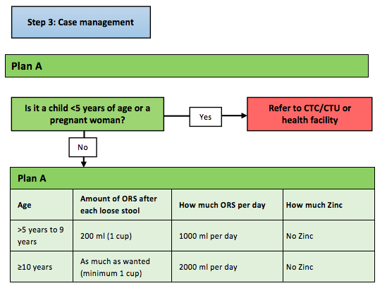
Decision Flow Chart for treatment and referral (3/4)

Slide 24
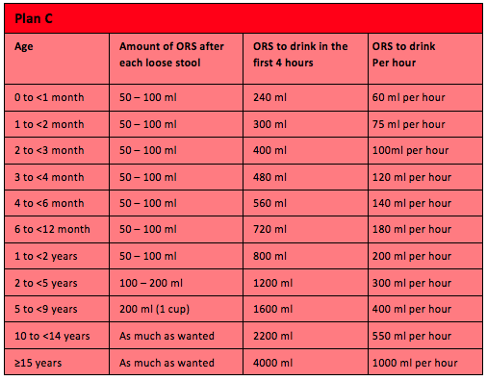
Decision Flow Chart for treatment and referral (4/4)
For referred patients
Patients should drink ORS while waiting for transport / during transport to CTC
Only patients that are able to drink – never try to rehydrate unconscious patients
Mothers should continue to breastfeed while going to the CTC
50 ml = ¼ cup
100 ml = ½ cup
200 ml = 1 cup

Slide 25
Referral Procedure
TO REFER:
    All children < 5 years (even if no dehydration)
    All Pregnant women (even if no dehydration)
    All patients with severe or even some dehydration
    Bloody/mucous diarrhea cases (Refer to Health Facility)
    Persistent diarrhea cases >2 weeks (Refer to Health Facility)
    Patients not able to drink ORS
    Patients with continuous vomiting or diarrhea
    Patients who are not improving
    All cases you are worried about
MAKE SURE PATIENT / CARETAKER:
Knows where is the nearest cholera treatment center (CTU/CTC)
Understands the need to go quickly to the CTU/CTC
Is given a referral ticket with key patient information
Is given ORS to drink while on his way to the CTU/CTC
Will find a way to reach the nearest health center with family or friends
If not, see with the community if there is a way to support referral

Slide 26
REFERRAL
CHOLERA TREATMENT CENTER (CTC)
CHOLERA TREATMENT UNIT (CTU)
LOCATION
FOCAL POINT
(NAME / PHONE NUMBER)
HEALTH CENTER
LOCATION
FOCAL POINT
(NAME / PHONE NUMBER)

Slide 27
Home treatment
INFORMATION TO GIVE BEFORE SENDING A PATIENT BACK HOME:
What is ORS (=water/salt/sugar + electrolytes) to facilitate rehydration
Need to drink ORS until diarrhea stops – ORS does not prevent or treat diarrhea
How to prepare ORS sachets or Home-made ORS
Need to prepare ORS with clean hand & clean water at home
When to give ORS (daily amount, plus additional amount after loose stool)
How to give ORS (small sips, stop 10 minutes if vomiting before restarting)
How to store ORS and discard at the end of each day - prepare a new solution the next day
Continue to breastfeed / feed and drink
When to come back at the ORP or go to CTC
  If not able to drink ORS
  If continuous vomiting or diarrhea
  If feeling worse or not improving
  If need more ORS
Key messages for cholera prevention
+ GIVE ORS SACHETS FOR 3 DAYS

Slide 28
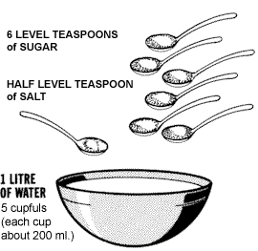
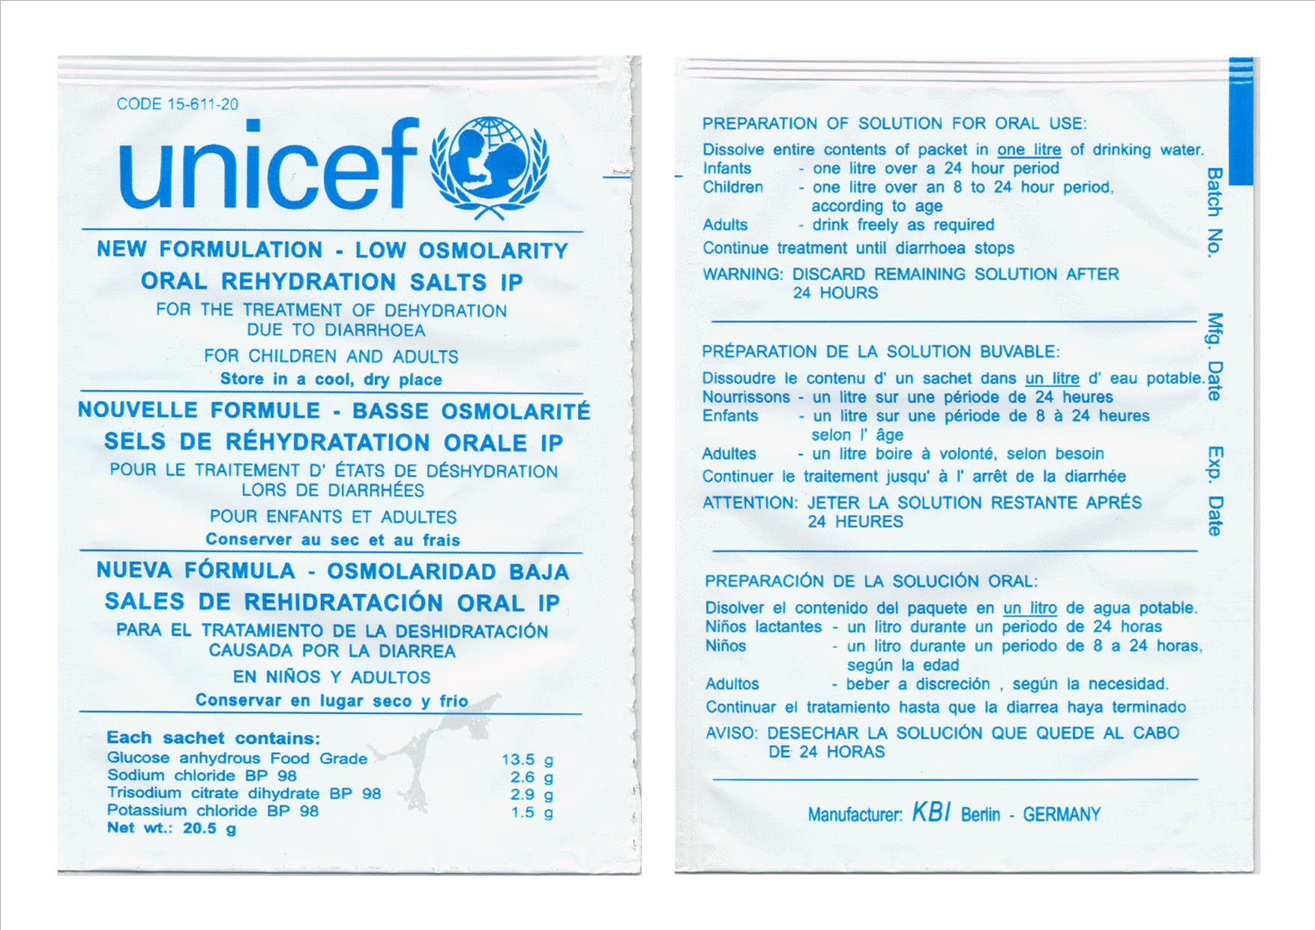
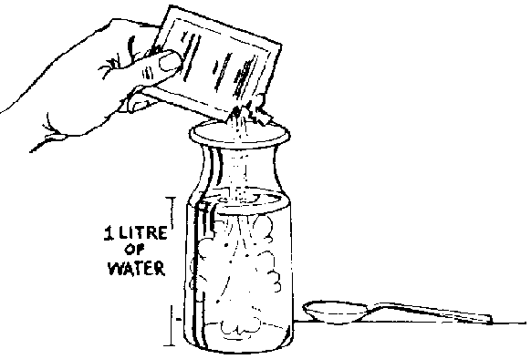
How to prepare Oral Rehydration Solutions
1 – WASH your hands with Soap and clean water
2 – WASH container and utensil with soap and clean water
3 – Put 1 Liter of safe, treated water in a clean container
Home – made ORS Solution
Already Prepared Powder – ORS Sachets
1 Liter Safe WATER
1 ORS Sachet
Notes:
Schema de ORS – Préparation d’une solution Sucrée Salée – ou a partir d’un sachet d’ORS

Slide 29
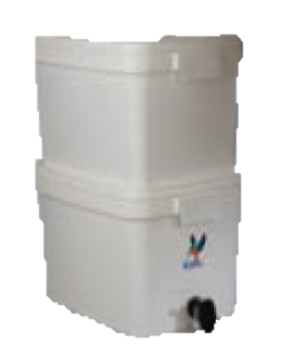
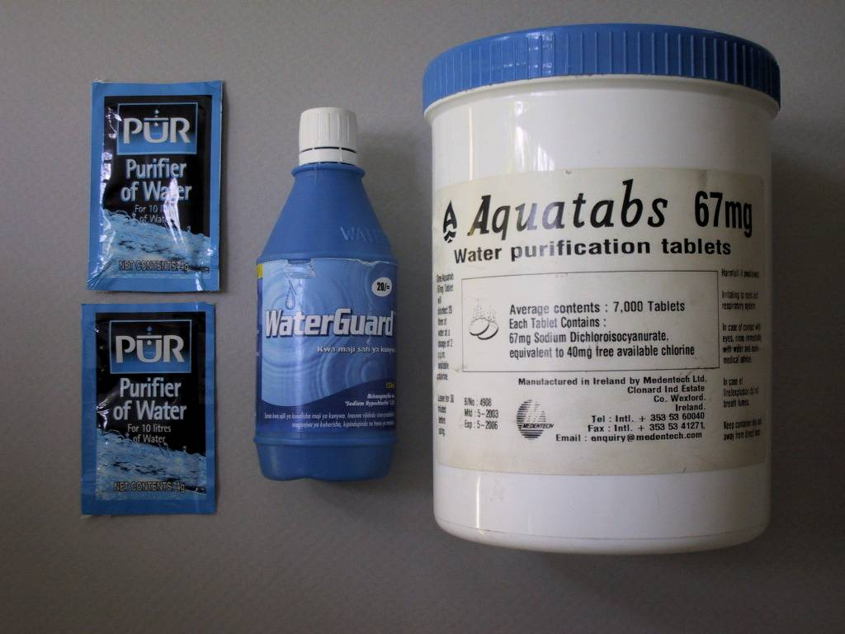
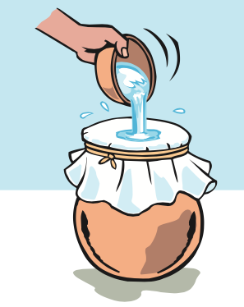
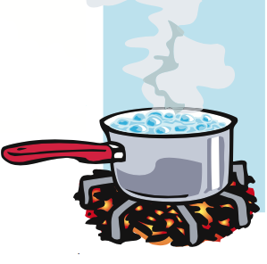
How to prepare Clean Water for ORS
Use of a water filter
Use of chemical water treatment products (aquatabs, bleach, chlorine, PUR, etc.)
Filtering (straining) & Boiling
+
Always use water than has been properly treated for the preparation of ORS !!
Notes:
Schema de ORS – Préparation d’une solution Sucrée Salée – ou a partir d’un sachet d’ORS

Slide 30
How to prepare Chlorine Solutions
Chlorine Solutions | Solution 0,05% | Solution 0,2% | Solution 2%
Uses | Handwashing, washing clothes, ustensils, dishes | Disinfection of shoes, floors, beds, chairs, footbaths | Feces, vomit
How often to prepare solutions | Daily | Daily | Weekly if stored properly
Aquatabs (NaDcc 1g/tablet) | 5 tablets / 10L | 20 tablets / 10L 2 tablets / 1L | 20 tablets / 1L
Bleach (5% active chlorine) | 100 mL / 10L 10 mL / 1L | 400 mL / 10L 40 mL / 1L | - 400 mL / 1L
HTH (70% active chlorine) | 0.7 g/L ½ tablespoon / 10L | 3 g/L 2 tablespoon / 10L | 30 g/L 2 tablespoon / 1L
Make your own recipe
Notes:
Schema de ORS – Préparation d’une solution Sucrée Salée – ou a partir d’un sachet d’ORS

Slide 31
Infection Prevention & Control at the ORP
Hand Hygiene for staffs
On entering the ORP
Before preparing ORS solutions, or giving ORS to drink to a patient
Before eating, drinking (or smoking)
After handling soiled laundry, waste, cleaning spills or emptying excreta buckets
After contact with vomit or any other body fluids
After going to the toilets
On leaving ORP
Hand Hygiene for Patients / Attendants
On entering the ORP
Before drinking ORS or giving ORS to drink
Before eating (or smoking)
Before preparing food for a patient
After contact with vomit or any other body fluids
After handling soiled laundry
After going to the toilets
On leaving ORP
Notes:
Schema de ORS – Préparation d’une solution Sucrée Salée – ou a partir d’un sachet d’ORS

Slide 32
Infection Prevention & Control at the ORP
Basic PPE – Personal Protective Equipement for ORP staff
Short-sleeved top + 1 pair of trousers (locally procured is fine)
1 pair of boots
Staff change on entering and leaving the ORP. Staff must neither leave the ORP in their protective clothing nor work in the ORP in their personal clothes.
Additional PPE
Reusable rubber gloves
Reusable plastic apron
Reusable face shield
For the preparation of chlorine solutions; collection, transport and washing/disinfection of soiled laundry or materials, dishes; for elimination of wastewater, feces, vomit, and waste.
NB: Respiratory masks (FFP 1, 2 or 3) protect against dust (e.g. removing
ashes, sweeping the waste storage area) but not against gases or vapours. Cholera is not transmitted by the inhalation of droplets. It is pointless to wear a surgical mask
or FFP2 respirator to protect oneself against cholera.
Notes:
Schema de ORS – Préparation d’une solution Sucrée Salée – ou a partir d’un sachet d’ORS

Slide 33
Infection Prevention & Control at the ORP
Floors, Surfaces and utensils
Wash floors with detergent, rinse and disinfect with 0.2% chlorine solution 2x/day or each time it is soiled
Wash surfaces (table, chairs, etc.) with detergent, rinse and disinfect with 0.2% chlorine solution at the end of the day
After each patient, wash patient chair, cups, spoons with detergent, rinse, and disinfect with 0.2% chlorine solution
Vomit buckets
Give a new bucket to patient with 1 cm of 2% chlorine solution at the bottom
Empties patient vomit bucket when a third full into the latrine pit
Rinse the bucket with clean water and disinfect with 0.2% solution
Waste
Collect and secure waste bags in the waste management area 1x/day
Wash dirty bins with detergent, rinse and disinfect with 0.2% chlorine solution
Eliminate waste (burn or burry)
Clean the waste area
Notes:
Schema de ORS – Préparation d’une solution Sucrée Salée – ou a partir d’un sachet d’ORS

Slide 34
Infection Prevention & Control at the ORP
Laundry / staff PPE
PPE is changed every day and each me it is soiled.
Soiled PPE are collected by staff wearing plastic aprons and rubber gloves;
washed separately with soap and water or with detergent available on the local market, rinsed in clear water, soaked in 0.05% chlorine solution for 15 minutes, rinsed in clear water again and hung out in the sun until completely dry.
Disinfection of shoes (optional)
Foot bath are not recommended
Spraying with 0.2% chlorine solution the shoe sole at the exit of the ORP
NB: The effectiveness of this measure in stopping the spread of vibrio in and outside an ORP or a CTC has not been demonstrated. However shoe disinfection points can serve to raise awareness among patients/attendants on the need for exceptional measures related to the contagious nature of cholera.
Notes:
Schema de ORS – Préparation d’une solution Sucrée Salée – ou a partir d’un sachet d’ORS

Slide 35
Key messages for Cholera Prevention
GENERAL PREVENTION MESSAGES
SAFE WATER - Drink safe water : treated (boiled or with added chlorine) and safely stored in clean, covered containers.
HANDWASHING - Handwash with soap at key moments (after defecation; after cleaning a child bottom and disposing of children feces properly; before and after taking care of a sick family member; before preparing food, before eating, before breastfeeding or taking care of a child)
SAFE FOOD HYGIENE - Cook food well, eat it hot, keep it covered, and peel / clean fruits and vegetables. Do not eat outside or in places where you are not sure of food hygiene.
USING LATRINES - Use latrines or bury your feces (do no practice open defecation)
CLEANING UP — Keep utensils & surfaces clean, in latrines, in kitchen and places where your family bathes and washes clothes.

Slide 36
Key messages for Cholera Prevention
SPECIFIC PREVENTION MESSAGES: TAKING CARE OF A CHOLERA PATIENT AT HOME
Stools, vomit and soiled clothes of cholera patients are highly contagious and should be handled safely.
Be prepared in case patient vomits (If patient vomits regularly and is not able to drink ORS, refer to the CTU/CTC). Collect patient vomit into a bucket used for this purpose and this purpose only. After use – empty bucket into latrine pit, wash and disinfect the bucket with bleach over the latrine pit. Carefully wash hands.
Carefully wash hands with clean water & soap after taking care of a sick patient or before taking care of someone else. Wash hands and containers, utensils with clean water & soap before preparing ORS or clean water. Wash hands, containers, utensils with clean water & soap before preparing or eating food (or smoking).
Cleaning vomit/diarrhea spills: Remove vomit/fluid spills with a cloth (put dirty cloth in a bucket), clean floor with water/soap then disinfect by pouring bleach and let dry. Wash contaminated cloth and bucket with water and soap over the latrine pit, soak cloth in bleach water for 15 minutes, rinse over the latrine pit, than hang to dry in the sun.
Cleaning contaminated clothes / materials: Wash contaminated materials with water and soap / detergent, rinse, disinfect by dipping into bleach solution for 15 minutes, rinse and let dry in the sun.
NB: Be careful of where you dispose of your contaminated used water. Pour used water into the latrines and then rinse / disinfect your bucket – let dry in the sun. Wash hands.

Slide 37
Reporting
BISHA # 0903 # 24 # 2 # 22 # 0 # 5 # 79
Daily SMS Report:
[Name of location] # Day [DDMM] # Total number of cases # cases under 5 # cases above 5 # number of community deaths # number of cases referred # ORS in stock
Notes:
SMS message should include:
[Name of location] # D [DDMM] # Total number of cases #cases under 5 # cases over 5 # number of deaths from AWD # number of cases referred # ORS in stock # Zinc in Stock
Location: BISHA
Date: 09/03
Total diarrhea/cholera cases: 24
Cases under 5: 2
Cases above 5: 22
Community deaths: 0
Referrals to CTUs/CTCs: 5
ORS sachets in stocks: 79

