Slide 1
Cholera & Oral Rehydration Therapy Community ORT Volunteer Manual
Notes:
Register participants
Official opening and recitals

Slide 2
Acknowledgements

Slide 3
What does a Community ORT Volunteer do?
p. 4 -22
1 – INFORM
Deliver messages on Cholera awareness , household and community prevention actions and inform their community that they are the “go to” person when someone has diarrhoea
2 – PREPARE
Works with their community to make it a ‘cholera ready’ community
3 – TREAT
Assess patient´ status, type of diarrhoea, level of dehydration and treat or refer accordingly
4 – REPORT
Log in patient information in the line list and send weekly report / SMS to their supervisor
5 – ALERT
Alert supervisor and Health system when identify sudden increase in AWD or suspicion of cholera cases
p. 23-26
p. 27-39
p. 40-41
p. 42

Slide 4
1. CHOLERA AWARENESS. Reducing Cholera Transmission
INFORM
What is cholera? Cholera is a very small bacteria.
Main symptoms are acute watery diarrhoea with or without nausea / vomiting.
Acute watery diarrhoea = 3 or more loose stools in a day.
Acute = sudden onset, appears “out of nowhere”.
Watery = liquid and looks like “rice water”.
Cholera leads to dehydration and this needs to be treated rapidly because it can lead to death within hours.
Small children and pregnant women are at higher risk of severe outcomes.
Dehydration can easily be treated – just drink the appropriate amount of oral rehydration salt.
How is cholera transmitted?
Cholera bacteria can be found in our faeces and from there transmitted to our body through different pathways:
Drinking untreated, contaminated water.
Preparing food with unwashed hands – eating contaminated food.
Eating with unwashed hands.
Feeding a child with unwashed hands.
Flies carry the cholera germs on their feet and can contaminate food and utensils.
4

Slide 5
1. CHOLERA AWARENESS. Reducing Cholera Transmission
INFORM
5

Slide 6
1. Key messages for Cholera Prevention. Cholera Protective Behaviours
INFORM
GENERAL PREVENTION MESSAGES
HOUSEHOLD WATER TREATMENT AND SAFE WATER STORAGE - Drink safe water : treated (boiled or with added chlorine) and safely stored in clean, covered containers.
HANDWASHING - Handwash with soap at key moments (after defecation; after cleaning a child bottom and disposing of children feces properly; before and after taking care of a sick family member; before preparing food, before eating, before breastfeeding or taking care of a child).
SAFE FOOD HYGIENE - Cook food well, eat it hot, keep it covered, and peel / clean fruits and vegetables. Do not eat in places where you are not sure of food hygiene.
USING LATRINES - Use latrines or bury your feces (do no practice open defecation).
CLEANING UP — Keep utensils & surfaces clean, in latrines, in kitchen and places where your family bathes and washes clothes.
6

Slide 7
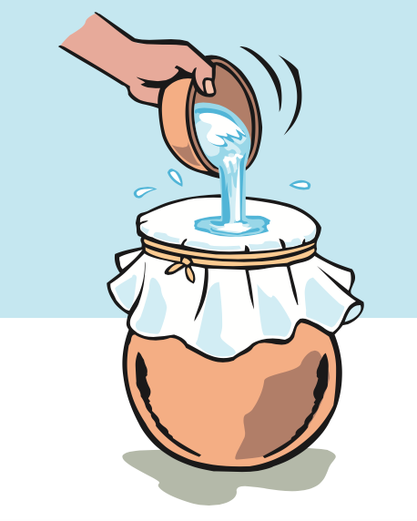
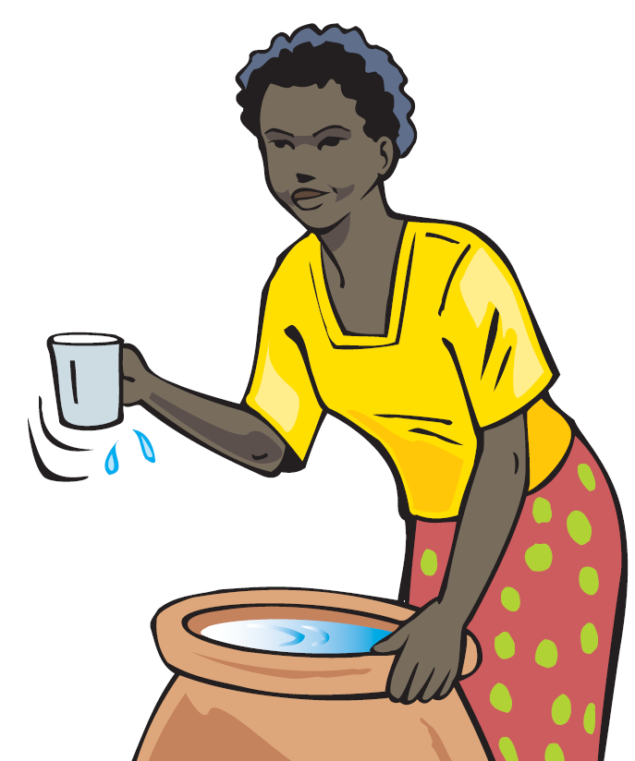
INFORM
1. Cholera protective behaviours: household water treatment
There are different ways to treat the water for different types of water:
FOR MUDDY/CLOUDY WATER
USE “PUR” SACHETS it helps both to remove suspended matter and disinfect water
OR
STRAIN / FILTER the muddy/cloudy water to obtain CLEAN/CLEAR WATER and then treat
Straining alone is unlikely to make water from a contaminated source completely safe to drink
But it makes household water treatment easier
FOR CLEAN / CLEAR WATER
BOIL WATER
USE HOUSEHOLD BLEACH, or WATERGUARD
USE AQUATABS
Use a cup with a handle to get water from your water container - never touch water with your hands
Always wash your hands with soap before handling water
keep the water safe from the source to the mouth
Keep your water collecting and storing containers clean
Always cover your water containers
7
Notes:
EXPLAIN: HOW TO WASH HANDS WITH SOAP
DEMONSTRATE HOW TO WASH/RUB HANDS/RINCE

Slide 8
INFORM
1. Cholera protective behaviours: household water treatment
How to treat water with PUR sachet
Stir
well
Leave the
water
If water is not clear, stir again until the floating dirt is separated
Pour contents of the PUR sachet into 10 litres bucket
Wash your hands with water and soap or ash
Stir the mixture for 5 minutes. Wait 5 min
Use thick cotton cloth
without any holes
Dispose of the filtered dirt away from children and animals
Prepared water
Do not drink if water is yellow in colour
Pour the treated water into a container through a clean cloth filter
Wait for 20 minutes
Your water is ready to drink. Do not drink if your water is yellow !
8

Slide 9
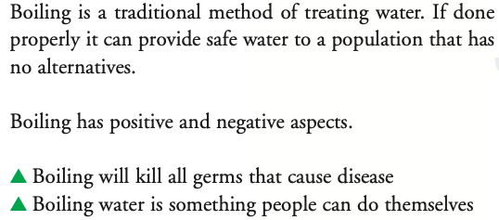
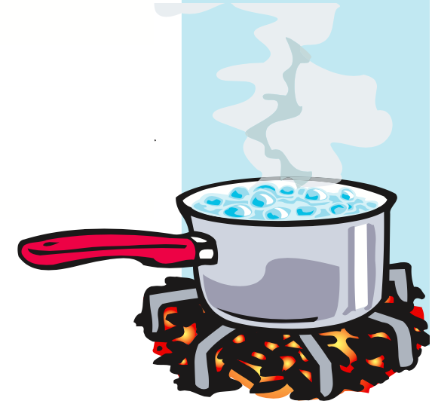
INFORM
1. Cholera protective behaviours: household water treatment
Boiling (For 1 minute)
9

Slide 10
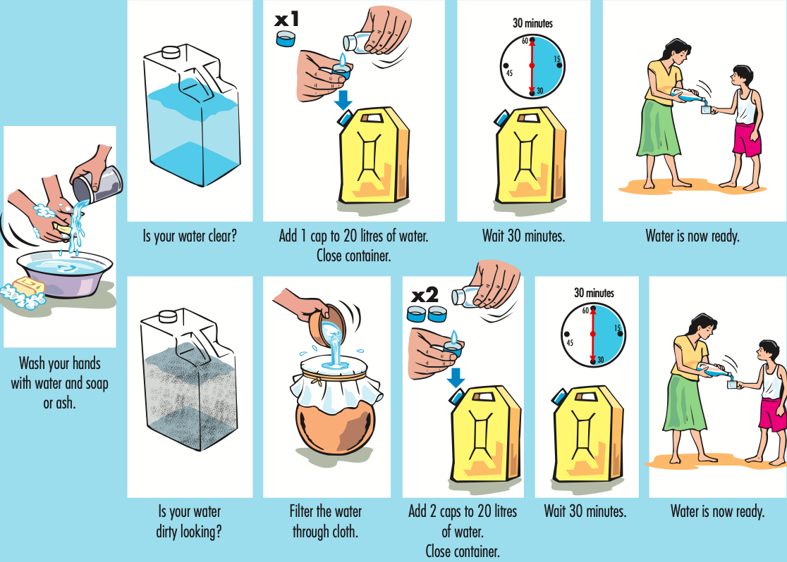
INFORM
1. Cholera protective behaviours: household water treatment
How to treat water with WaterGuard
10
Notes:
MAKE SURE WATER IS CLEAR
WATERGUARD = USUALLY 1 CAP – 20 L of WATER
HOUSEHOLD BLEACH = 1 drop/L of water (20 drops – 20 L)

Slide 11
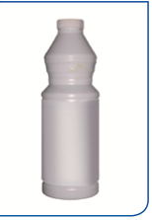
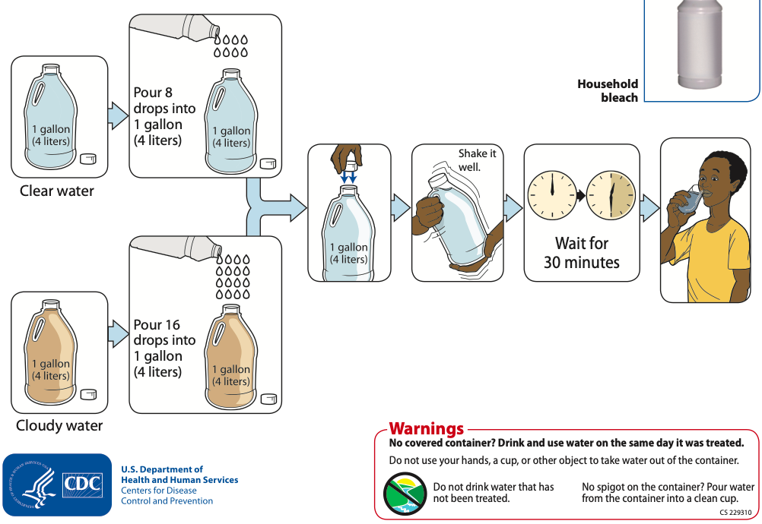
INFORM
1. Cholera protective behaviours: household water treatment
Making drinking water safe with household bleach
11
Notes:
MAKE SURE WATER IS CLEAR
WATERGUARD = USUALLY 1 CAP – 20 L of WATER
HOUSEHOLD BLEACH = 1 drop/L of water (20 drops – 20 L)

Slide 12
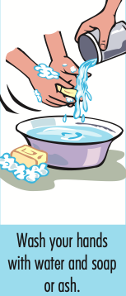
INFORM
1. Cholera protective behaviours: household water treatment
How to treat water with chlorine tablet
12
Notes:
MAKE SURE WATER IS CLEAR
WATERGUARD = USUALLY 1 CAP – 20 L of WATER
HOUSEHOLD BLEACH = 1 drop/L of water (20 drops – 20 L)

Slide 13
INFORM
1. Cholera protective behaviours: household water treatment
Safe water storage
14
Notes:
EXPLAIN: HOW TO WASH HANDS WITH SOAP
DEMONSTRATE HOW TO WASH/RUB HANDS/RINCE

Slide 14
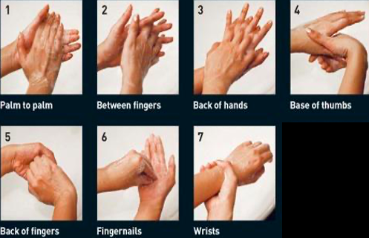
INFORM
1. Cholera protective behaviours: hand washing
Frequent and proper handwashing will protect you.
Soap (or ash) helps remove dirt and cholera germs from hands.
Unwashed (or poorly washed) hands transfer cholera germs to food, water, and household surfaces.
Rub your hands together and let them air dry
15
Notes:
EXPLAIN: HOW TO WASH HANDS WITH SOAP
DEMONSTRATE HOW TO WASH/RUB HANDS/RINCE

Slide 15
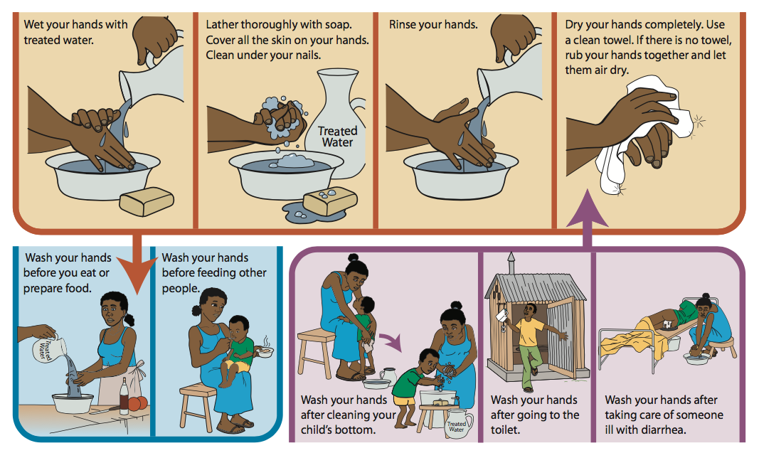
INFORM
1. Cholera protective behaviours: hand washing
16
Notes:
EXPLAIN: HOW TO WASH HANDS WITH SOAP
DEMONSTRATE HOW TO WASH/RUB HANDS/RINCE

Slide 16
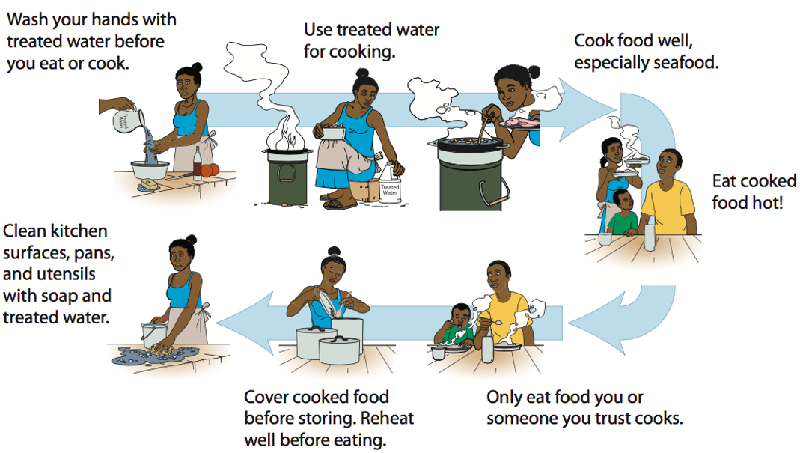
INFORM
1. Cholera protective behaviours: safe food preparation
16
Notes:
EXPLAIN: HOW TO WASH HANDS WITH SOAP
DEMONSTRATE HOW TO WASH/RUB HANDS/RINCE

Slide 17
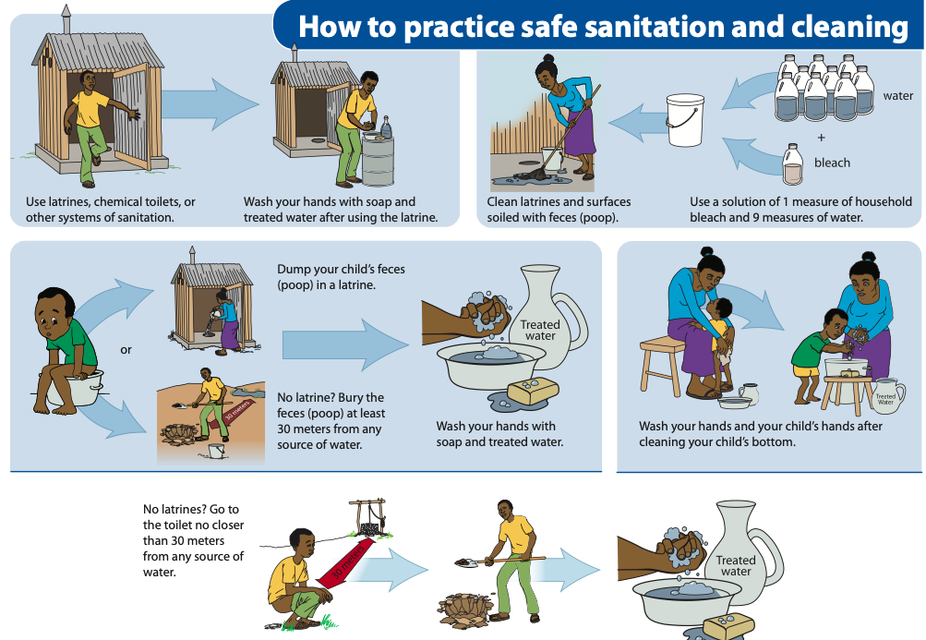
INFORM
1. Cholera protective behaviours: safe sanitation and cleanings
17
Notes:
EXPLAIN: HOW TO WASH HANDS WITH SOAP
DEMONSTRATE HOW TO WASH/RUB HANDS/RINCE

Slide 18
INFORM
1. Cholera protective behaviours: safe sanitation and cleanings
18
Notes:
EXPLAIN: HOW TO WASH HANDS WITH SOAP
DEMONSTRATE HOW TO WASH/RUB HANDS/RINCE

Slide 19
1. CHOLERA PROTECTIVE BEHAVIOUR DURING CHOLERA OUTBREAKS Limiting the organization and attendance at mass gatherings
INFORM
Attendance at mass gathering is a risk factor for Cholera infection.
Usual duration of Cholera outbreaks is 3-12 weeks.
Avoiding the organization and attendance at mass gatherings during. cholera outbreaks can help limit the spread of cholera.
How to limit the attendance and organization of mass gathering ?
Inform the population of the risk of spreading cholera during such events.
Suggest not attending mass events until cholera outbreak ends.
Discourage the organization of mass events.
19

Slide 20
1. CHOLERA PROTECTIVE BEHAVIOUR DURING CHOLERA OUTBREAKS. Specifically addressing the issue of community deaths and funeral organization
INFORM
When a suspected Cholera case Dies in the community…
Local officials or a health care worker should be contacted immediately.
When a person with cholera dies, their body releases fluids that can contain cholera germs.
Special care should be taken when preparing the body for burial, so others do not get ill with cholera.
If possible, family members should not handle or touch the body. The burial of the body should be supervised by local authorities or a health care worker.
Funerals should be held within hours of death, if possible.
20

Slide 21
INFORM
1. CHOLERA PROTECTIVE BEHAVIOUR DURING CHOLERA OUTBREAKS. Specifically addressing the issue of community deaths and funeral organization
CORPSE PREPARATION
People should not kiss, touch, or hold the body.
The body should be disinfected / prepared by a trained health personnel.
Anyone who touches the body should wash hands well with soap and safe water.
Clean all the deceased person’s clothing and bedding with household bleach or by washing with soap and drying in the sun.
Mattresses can be disinfected by drying well in the sun.
Clean any surfaces the body touched with a solution that is 1 part bleach to 9 parts water.
Wash hands well with soap and safe water immediately after handling clothes of the deceased.
21

Slide 22
INFORM
1. CHOLERA PROTECTIVE BEHAVIOUR DURING CHOLERA OUTBREAKS. Specifically addressing the issue of community deaths and funeral organization
FUNERAL FEAST ORGANIZATION
Funeral feasts are often associated with cholera spread. They should be cancelled. If there is a feast, special care should be taken by all guests and family members to prevent the spread of cholera.
Do not prepare food if you prepared the body for burial or touched the body.
Do not touch the body during the funeral feast.
Wash hands often with soap and safe water (especially before eating).
Drink and use safe water for all household uses.
Cook food well, keep food covered, eat it hot, and peel fruits and vegetables.
Clean food preparation areas and kitchenware with soap and safe water and let dry completely before reuse.
Use latrines or other sanitation systems to dispose of feces.
If latrines or chemical toilets are unavailable, bury your feces.
22

Slide 23
2. “Cholera ready” community: How can we save lives?
PREPARE
23

Slide 24
2. “Cholera ready” community
ORT volunteers encourage community members to come together and take action
SETTINGS (examples)
TOPICS (examples)
PREPARE
Homes (house to house visits)
Community meetings
Churches / Mosque, etc.
Activity based groups
School classes and clubs
Funerals and public gatherings (markets, etc.)
Cholera Awareness
Cholera risk perception
Signs & Symptoms
What to do in case of AWD
Oral rehydration therapy & referral
Cholera protective behaviors
Limiting gatherings attendance
Precautions during funerals
Tell the community members to come to see you in case of diarrhea
If a household suspects a case, they should
see the community ORT volunteer
drink ORS the sooner the better
go to the nearest health facility
24
Notes:
ORT volunteers at community level are the entry point for the management of diarrhea in the community.
People in the community will come to them because they have diarrhea (not necessarily cholera) and seek for advice
Because they will fear it could be cholera
Because they think ORT volunteers can treat diarrhea

Slide 25
2. “Cholera ready” community
PREPARE
Community members should be made aware of the presence of cholera in the area when their area is affected – not all year round. The specific risk period should be mentioned so that people understand that it can happen annually.
Discuss with the community how they would handle the situation in case of a patient not being able to go to the health centre (too weak) or not able to afford the cost of transport (community solidarity mechanism).
Community members should be aware that as soon as they think they might have cholera – they should seek care as quickly as possible – with the ORT Volunteer or at the Health Centre.
25
Notes:
YOU CAN GIVE NUMBERS
YOU CAN GIVE EXAMPLES
YOU CAN EXPLAIN HOW SEEKING CARE EARLY HAVE SAVED LIVES BEFORE and THAT DESPITE THE EXISTENCE OF AVAILABLE SOLUTIONS, PEOPLE HAVE DIED BECAUSE THEY WERE NOT AWARE OR DID NOT TAKE THE RISK SERIOUSLY

Slide 26
2. “Cholera ready” community
What can we do to ensure that people suffering from dehydration have early access to oral rehydration ?
PREPARE
Community ORT Volunteers will work with their community, raising awareness about Cholera and providing ORS.
Be it cholera or not, sudden AWD should always be considered a DANGER sign.
ACUTE DIARRHEA DEHYDRATION POSSIBLY DEATH IF NOT TREATED.
Simply drinking ORS can stop dehydration (and save life).
Home made ORS can be used, but manufactured ORS sachets work better.
TELL COMMUNITY MEMBERS WHAT TO DO IN CASE OF AWD
Do not wait before seeking care.
The ORT volunteer will help evaluate the severity of dehydration and provide you with ORS and / or teach you how to prepare ORS at home.
If an ORT volunteer is not available, do not hesitate to go to the Health Center.
26

Slide 27
3. Treatment
TREAT
When Community ORT Volunteers see an individual with diarrhoea, they will:
Assess the type of diarrhoea.
Look for signs and symptoms of Acute Watery Diarrhoea (AWD) and take appropriate actions.
Assess the level of dehydration using the ASK-LOOK-FEEL routine.
Use the decision flow chart for treatment and referral.
If necessary, prepare and administer ORS and demonstrate this to individual or carer.
Advise on referral (Facilitate referral with assistance of the community).
TREAT
27

Slide 28
3. Assessing the type of diarrhoea
There are different types of diarrhoea and different actions to take:
Acute Watery Diarrhoea
Recent/sudden
W/Without vomiting
TREAT
Persistent Diarrhoea
> 2 weeks (14 days)
Diarrhoea
+ Fever or other complications
Bloody / Mucous Diarrhoea
Possibly Cholera ?
Acute = important loss of fluids
Treatment at community level, for no dehydration
Referral of all mild and severe cases and at risk populations
Refer to nearest
health centre
28

Slide 29
2. Assessing the level of dehydration of AWD/Cholera patients
TREATMENT
To assess the level of dehydration use this routine:
ASK – LOOK – FEEL
Ask about diarrhea: Watery (3 times a day), today ? Since when ?
Ask about thirst ? About urine (normal or very little)
Ask if he/she was able to eat/drink/breastfeed at all today ? Or vomiting ?
Look general condition: Is the person awake and can he/she speak to you? Can he/she walk? Or is he/she very weak ?
Look for sunken eyes (that go inside)
Look at the mouth/tongue – Are they dry ?
Feel. Pinch skin and see if it goes back to normal
29
Notes:
What happened to the child?
How many times a day has the child toilet watery poopoo?
How many days has the child‟s stomach been running?
Is the poo poo bloody or slippery?
Is the child able to drink or breastfeed? (Offer child breast or older child clean water in cup.)
Is the child eating?
Is the child vomiting? How many times in one day?

Slide 30
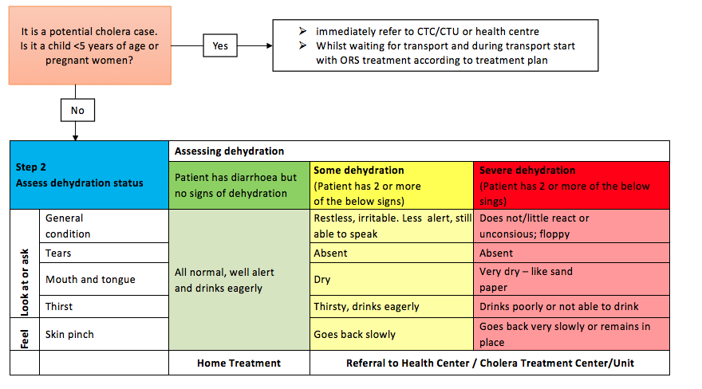
2. Decision Flow Chart for dehydration assessment
TREATMENT
30

Slide 31
2. Referral
ORT volunteers will not treat all cases. They will refer:
All children under 5 years (even if no dehydration).
All Pregnant women (even if no dehydration).
All patients with severe or even some dehydration.
Bloody/mucous diarrhoea cases (Refer to Health Facility).
Persistent diarrhea cases, more than 2 weeks (Refer to Health Facility).
Patients not able to drink ORS.
Patients with continuous vomiting or diarrhea.
Patients who are not improving.
All cases you are worried about.
TREAT
Ensure that the person will be able to reach the Health centre with the help of family or community members.
31

Slide 32
2. Amount of ORS to drink during transport
For referred patients
Patients should drink ORS while waiting for transport / during transport to CTC.
Only patients able to drink – never try to rehydrate unconscious patients.
Mothers should continue to breastfeed while going to the CTC.
TREATMENT
Amount of ORS to drink during transport to the health center or CTC/CTU
Age | ORS to drink per hour
0 to 6 months | 50 – 150 mL per hour
6 months to 2 years | 150 – 200 mL per hour
2 years to 5 years | 200 – 300 mL per hour
5 years to 15 years | 400 – 500 mL per hour
More than 15 years | 1000 mL per hour
50 ml = ¼ cup 100 ml = ½ cup 200 ml = 1 cup
Adapted from Médecins Sans Frontières. Management of a cholera epidemic. 2017 edition.
32

Slide 33
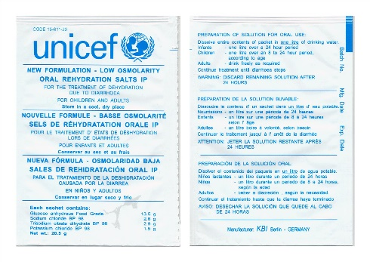
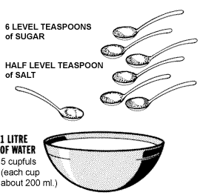
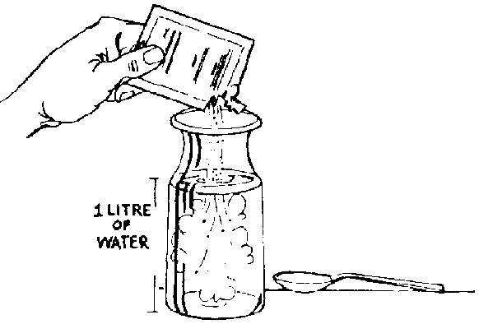
2. How to prepare Oral Rehydration Solution
If the general condition of the individual is normal, is well alert, and drinks eagerly give
him/her ORS, show how to prepare ORS and send him/her home with some advice.
TREATMENT
WASH your hands with Soap and clean water.
WASH container and utensil with soap and clean water.
Put 1 Liter of treated water in a clean container.
Home – made ORS Solution
Already Prepared Powder – ORS Sachets
1 Liter Safe WATER
1 ORS Sachet
1 Litre
of
Treated
Water
Treated
Water
33
Notes:
Schema de ORS – Préparation d’une solution Sucrée Salée – ou a partir d’un sachet d’ORS

Slide 34
2. Preparation of Oral Rehydration Solution
TREATMENT
Key messages for ORS preparation:
Always wash your hands before handling ORS.
For every person use a clean cup to serve ORS.
Clean the used cups, spoons and jars regularly.
Do not dilute or concentrate ORS – always follow the concentration mentioned in the sachet. If the sachet is for 1 litre, prepare 1 litre even if you use only ½ litre of ORS.
Store ORS in a clean, covered/closed container in the shade.
Do not keep mixed ORS solutions for more than 24 hours.
Throw away any mixed ORS solutions after 24 hours and prepare fresh one.
34

Slide 35
2. Consumption of Oral Rehydration Solution
TREATMENT
Key messages for ORS consumption:
Wash your hands before providing someone ORS.
ORS should be given regularly in small amounts / small sips out of a cup or spoon.
If someone vomits, wait 10 minutes and continue to give ORS but more slowly.
If vomiting continuous or you feel more sick consult to a health facility.
If diarrhoea continues consult to a health facility.
If no ORS is left come back to the ORT volunteer.
If a child is breastfed, continue breastfeeding and make sure that also the mother drinks a lot. Wash hands before breastfeeding.
Juices or mashed bananas can be added to make ORS taste better – whatever someone adds, it is important to make it in a hygienic manner – wash your hands before handling ORS.
Stop drinking ORS when diarrhoea stops.
Never force any liquid in a person that is unconscious – nor adults nor children!
35

Slide 36
2. Protocol for Home Treatment – No dehydration
TREATMENT
How much ORS should a person drink?
50 ml = ¼ cup 100 ml = ½ cup 200 ml = 1 cup
Give ORS for 3 days (3 sachets for children from 5 to 10 years old, 6 sachets for more than 10 years old and adults).
Explain / Show how to prepare ORS at home.
Explain to discard old ORS solution after 24h (at the end of the day) and prepare a new the next day.
Ask to come back if not improving or not able to drink/eat.
36

Slide 37
2. Home Treatment
Information to give before sending a patient & caregivers back home
What is ORS (=water/salt/sugar + electrolytes) to facilitate rehydration.
Need to drink ORS until diarrhoea stops – ORS does not prevent or treat diarrhoea.
How to prepare ORS sachets or Home-made ORS.
Need to prepare ORS with clean hands & clean water at home.
When to give ORS (daily amount, plus additional amount after loose stool).
How to give ORS (small sips, stop 10 minutes if vomiting before restarting).
How to store ORS and discard at the end of each day - prepare a new solution the next day.
Raise the importance of continue to breastfeed / feed and drink often.
When to come back at the ORP or go to CTC.
If not able to drink ORS / not eating / not breastfeeding.
If continuous vomiting or diarrhea.
If feeling worse or not improving.
If need more ORS.
Key messages for cholera prevention.
+ GIVE ORS SACHETS FOR 3 DAYS
(3 sachets for children, 6 sachets for older than 10 years and adults)
TREATMENT
37
Notes:
Schema de ORS – Préparation d’une solution Sucrée Salée – ou a partir d’un sachet d’ORS

Slide 38
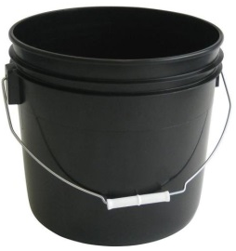
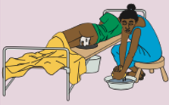
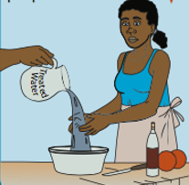
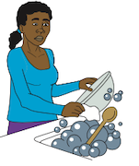
3. Cholera prevention messages
Specific prevention messages to give when sending a cholera patient at home
Stools, vomit and soiled clothes of cholera patients are highly contagious and should be handled safely.
Be prepared in case patient vomits (If patient vomits regularly and is not able to drink ORS, refer to the CTU/CTC). Collect patient vomit into a bucket used for this purpose and this purpose only. After use – empty bucket into latrine pit, wash and disinfect the bucket with bleach over the latrine pit. Carefully wash hands.
TREAT
Carefully wash hands with clean water & soap after taking care of a sick patient or before taking care of someone else. Wash hands and containers, utensils with clean water & soap before preparing ORS or clean water. Wash hands, containers, utensils with clean water & soap before preparing or eating food (or smoking).
38

Slide 39
3. Cholera prevention messages
Specific prevention messages to give when sending a cholera patient at home
Cleaning vomit/diarrhea spills: Remove vomit/fluid spills with a cloth (put dirty cloth in a bucket), clean floor with water/soap then disinfect by pouring bleach and let dry. Wash contaminated cloth and bucket with water and soap, discard this water over the latrine pit, soak cloth in bleach water for 15 minutes, rinse over the latrine pit, then hang to dry in the sun.
Cleaning contaminated clothes / materials: Wash contaminated materials with water and soap / detergent, rinse, disinfect by dipping into bleach solution for 15 minutes, rinse and let dry in the sun.
NB: Be careful of where you dispose of your contaminated used water. Pour used water into the latrines and then rinse and disinfect your bucket – let dry in the sun. Wash hands.
TREAT
39

Slide 40
4. Reporting on diarrhoea / cholera cases
THE PATIENT LOGBOOK – 1 LINE PER PATIENT
Each time you see a patient log in this information
Information on treatment provided and outcome
Information on village / ORT volunteer
Information on health condition at arrival
Information on patient
REPORT
Information on register entry
Information
on stocks
40

Slide 41
4. Reporting
Each week count and send:
# total diarrhea (AWD) cases (03)
# diarrhea (AWD) cases under 5 (02)
# diarrhea (AWD) cases over 5 (01)
# referrals to health center (01)
# diarrhea (AWD) deaths (00)
# ORS sachets in stocks (291)
SMS report
SMS message should include:
[Name of location] # W[Week number of the report]#Total number of cases #cases under 5 # cases over 5 # number of cases referred # number of deaths from AWD # ORS in stock
REPORT
BISHA#W10#03#02#01#01#00#291
41

Slide 42
5. Alert
What can trigger a cholera suspicion alert ?
(1) It looks (really) like cholera
(2) A sudden increase in the number of diarrhea cases
-
A group of AWD cases
(3) A Death from AWD in the community
Immediately report to your supervisor if you find any of these triggers
Investigation and essential information to gather:
You can help the health authorities if you are able to gather this information.
Number of cases (people sharing the same symptoms)
Date when first people got sick
History of travel of first cases ?
What have the cases in common ?
Been to a common gathering / event / funeral?
Shared a common meal ?
Draw water from the same source ?
ALERT
42

Slide 43
Write here key contact numbers:
RCRC Branch:_________________________________________________
Supervisor:___________________________________________________
Health Centre:________________________________________________
____________________________________________________________
____________________________________________________________
____________________________________________________________
43

